Slide 1
CS 111—Intro to Computational Science
Discussion Section Week 1
Notes:
Who did some coding this summer?

Slide 2
About Me
Steven Munn
sjmunn@cs.ucsb.edu
https://www.cs.ucsb.edu/~sjmunn/

Slide 3
Discussion Section Objectives
Install Anaconda on your computer
Witness the power of matplotlib
Survey debugging tools for Jupyter
Grasp the importance of visualization

Slide 4


What is Anaconda?

Slide 5



What is Anaconda?

Slide 6
The General Hierarchy
Package Manager
Interpreter
Applications/IDEs
Packages

Slide 7
Installing Anaconda Ubuntu 18

Slide 8
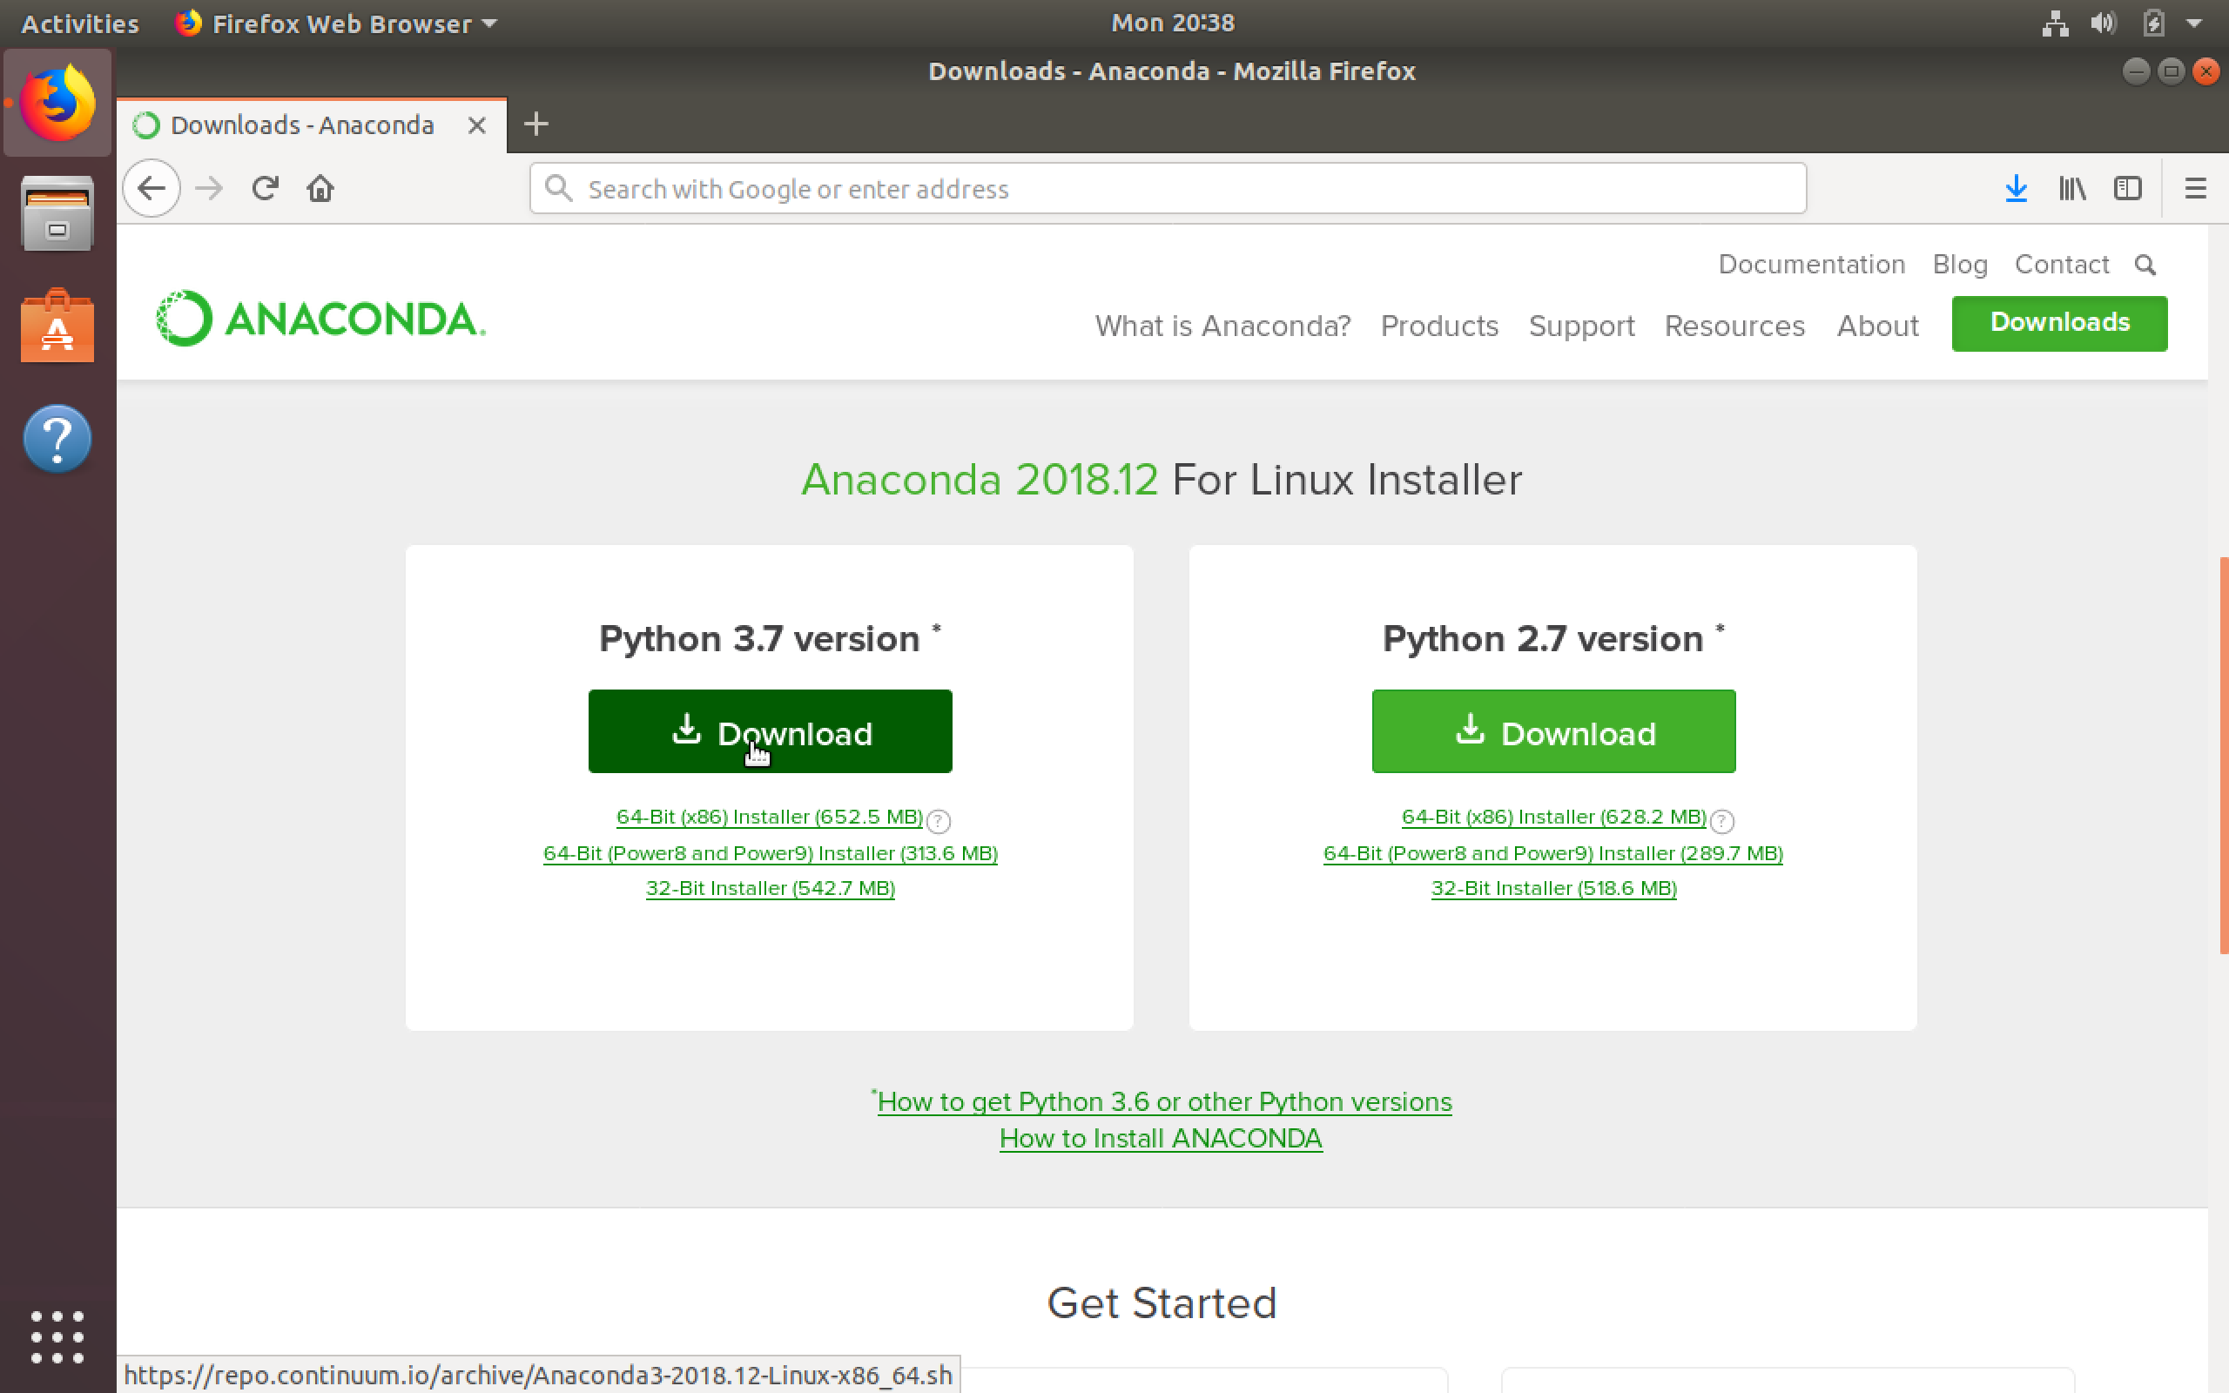
Go to the Anaconda Download Page
Click here

Slide 9
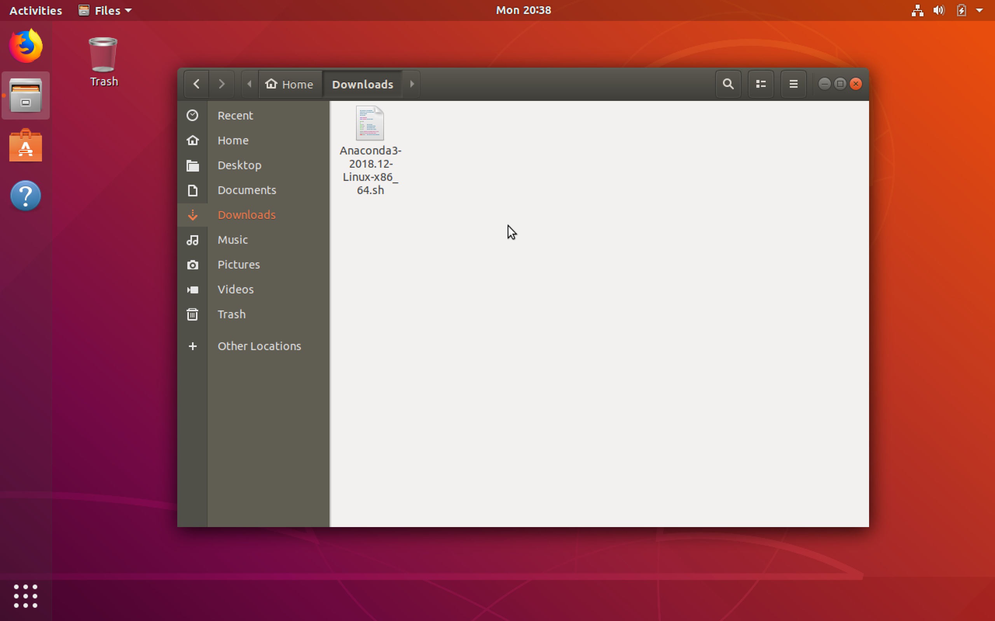
Open the ~/Downloads folder

Slide 10
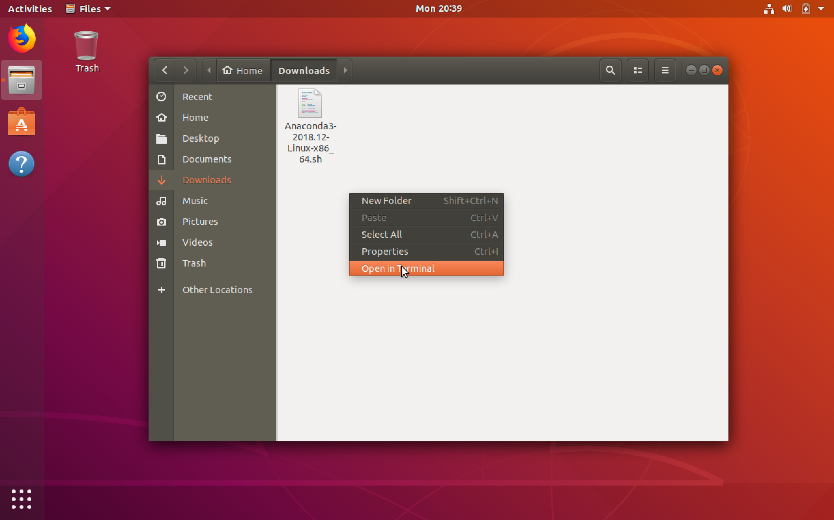
Right Click Open Terminal

Slide 11
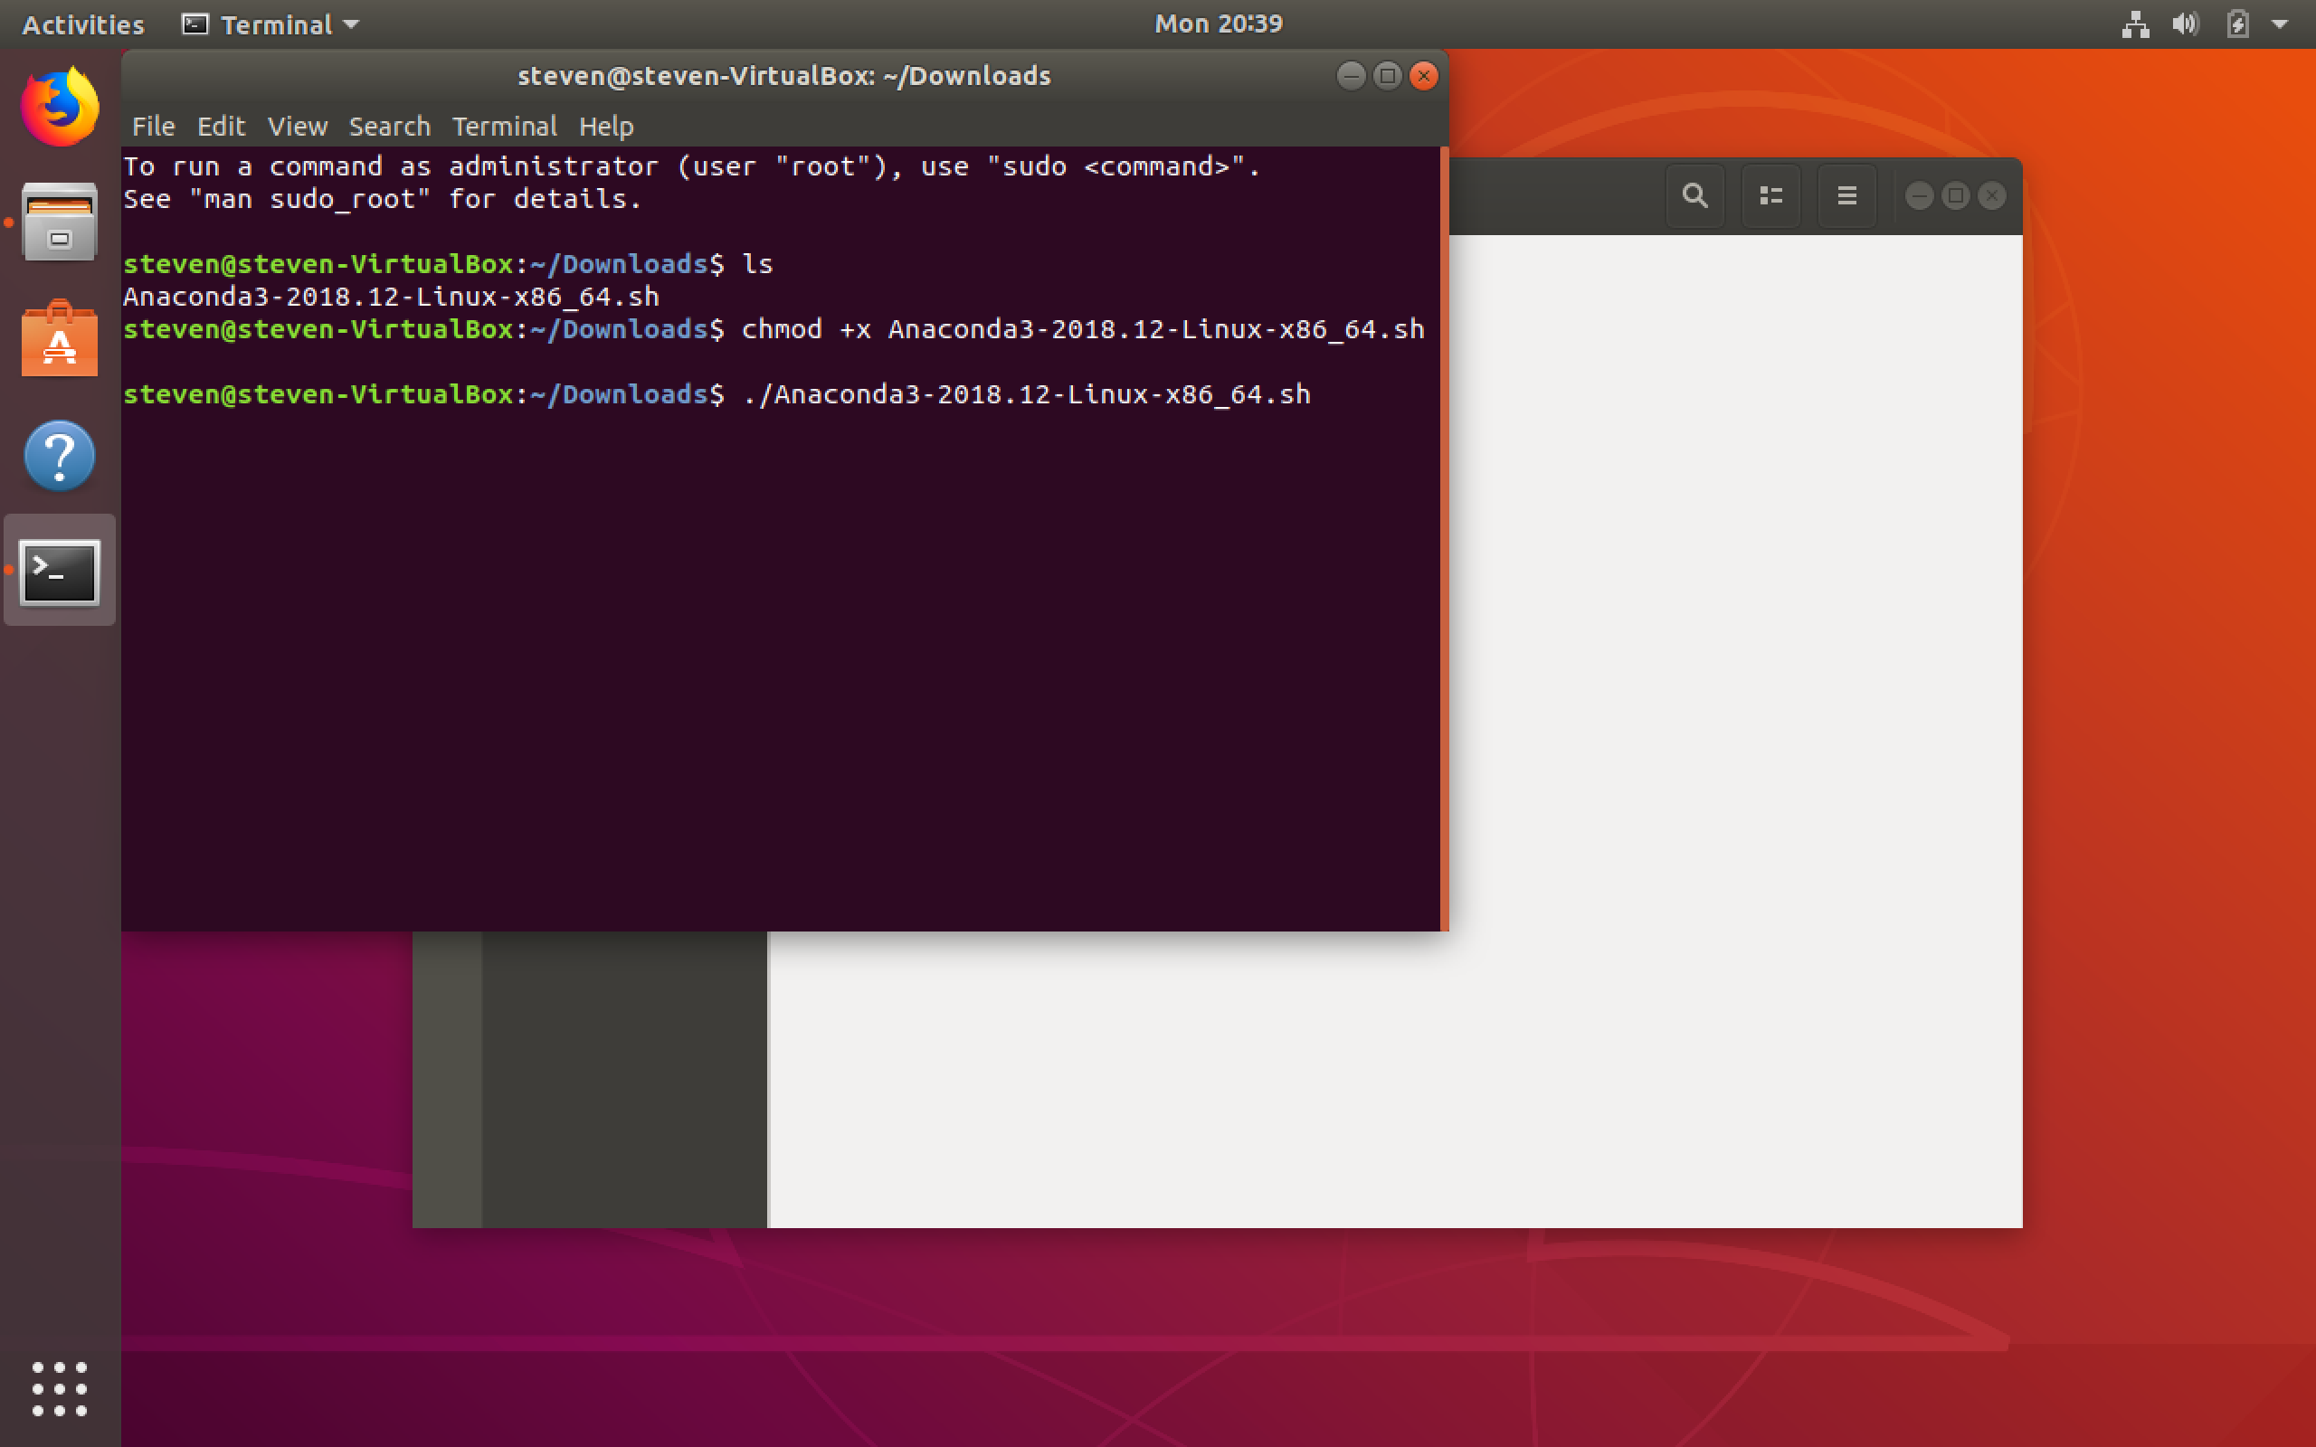
Change Permissions/Run Installer

Slide 12
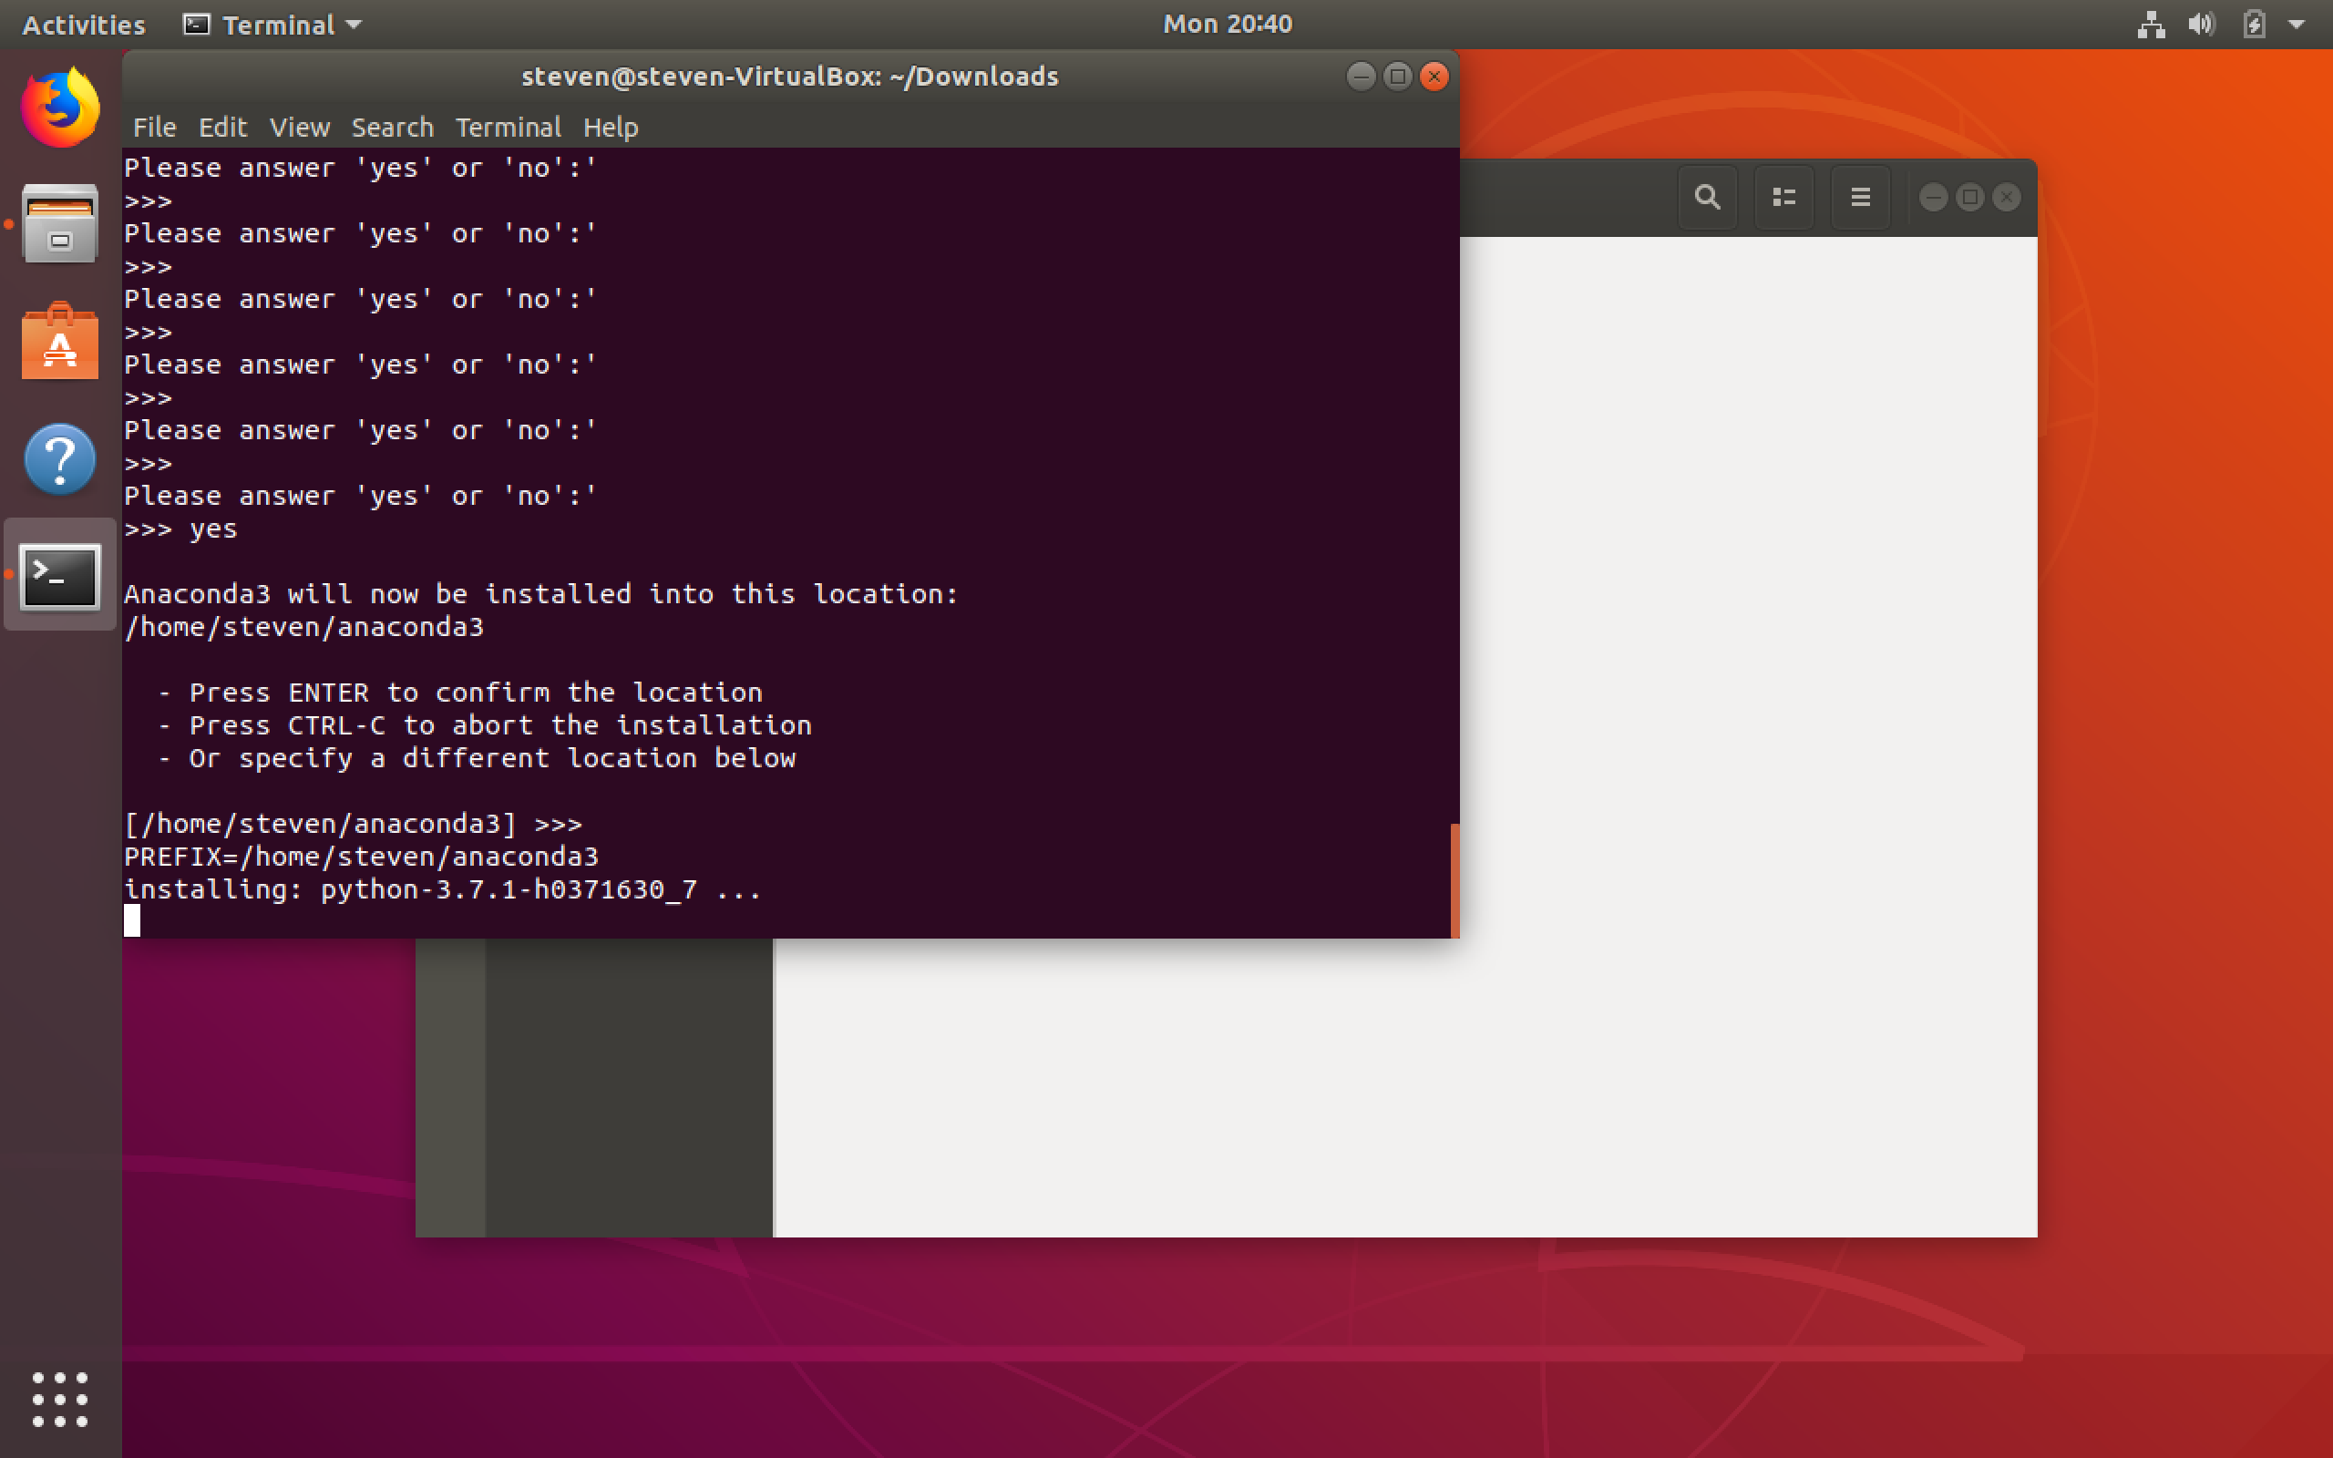
Follow Instructions

Slide 13
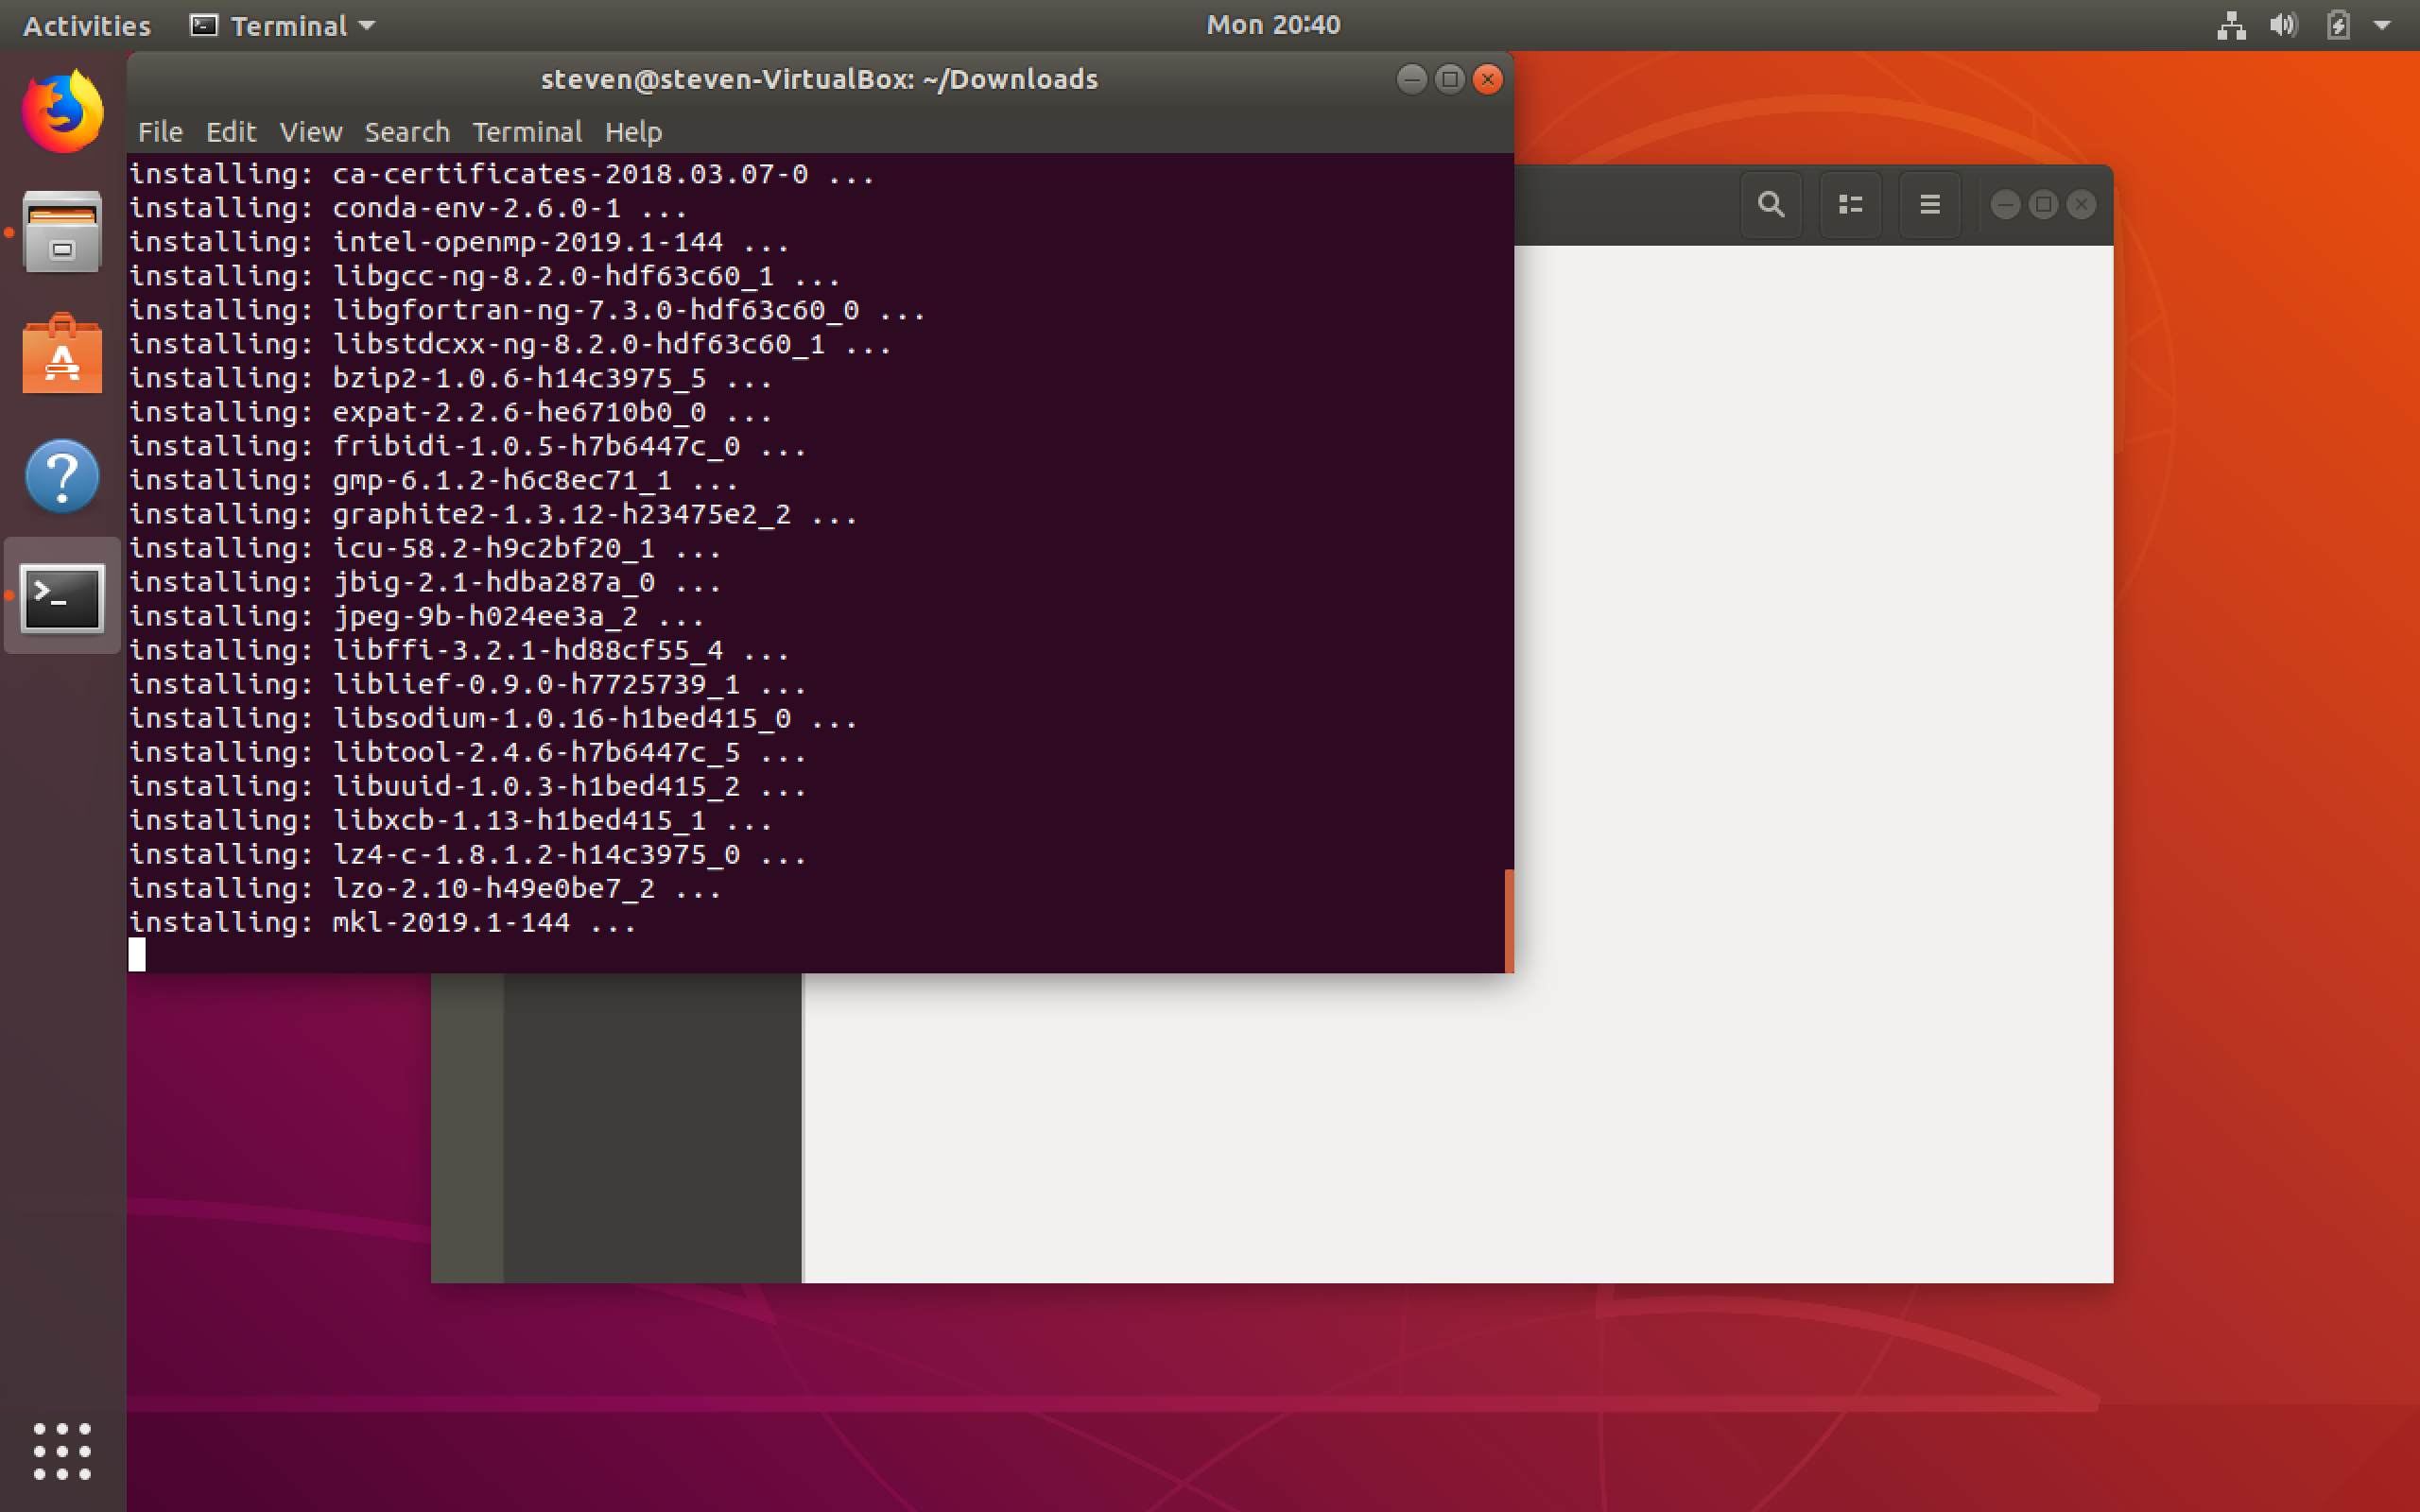
Grab your favorite book and relax for a while

Slide 14
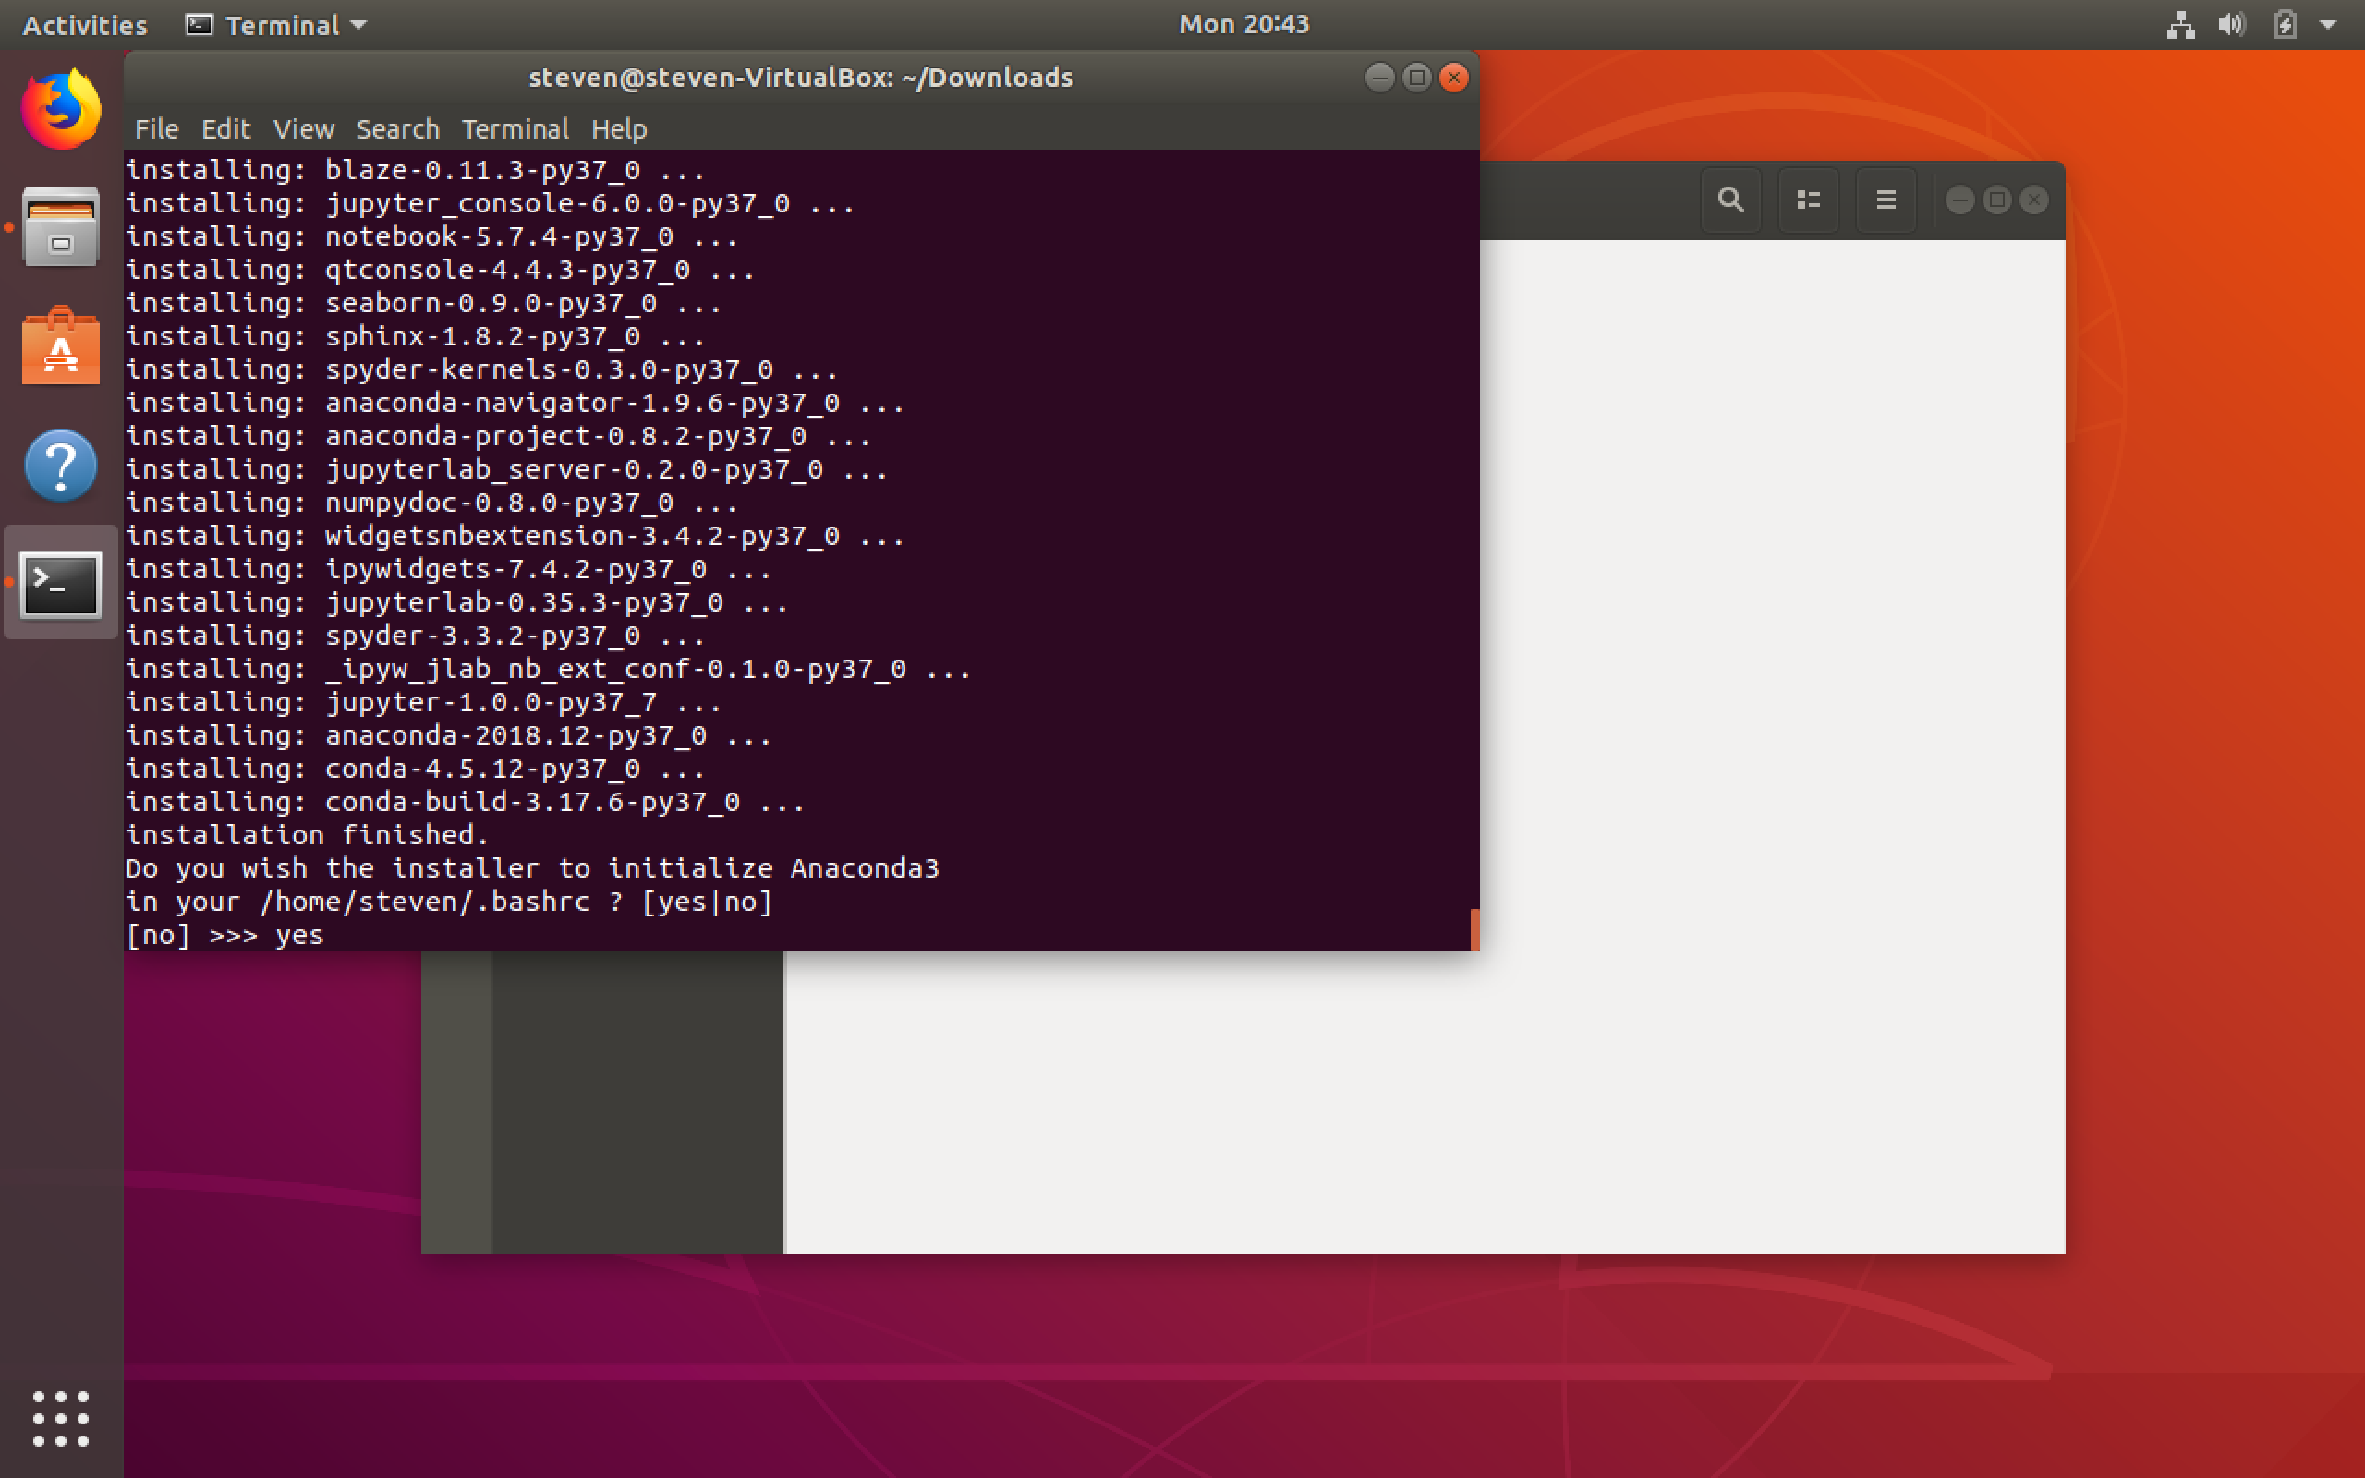
Set as default interpreter

Slide 15
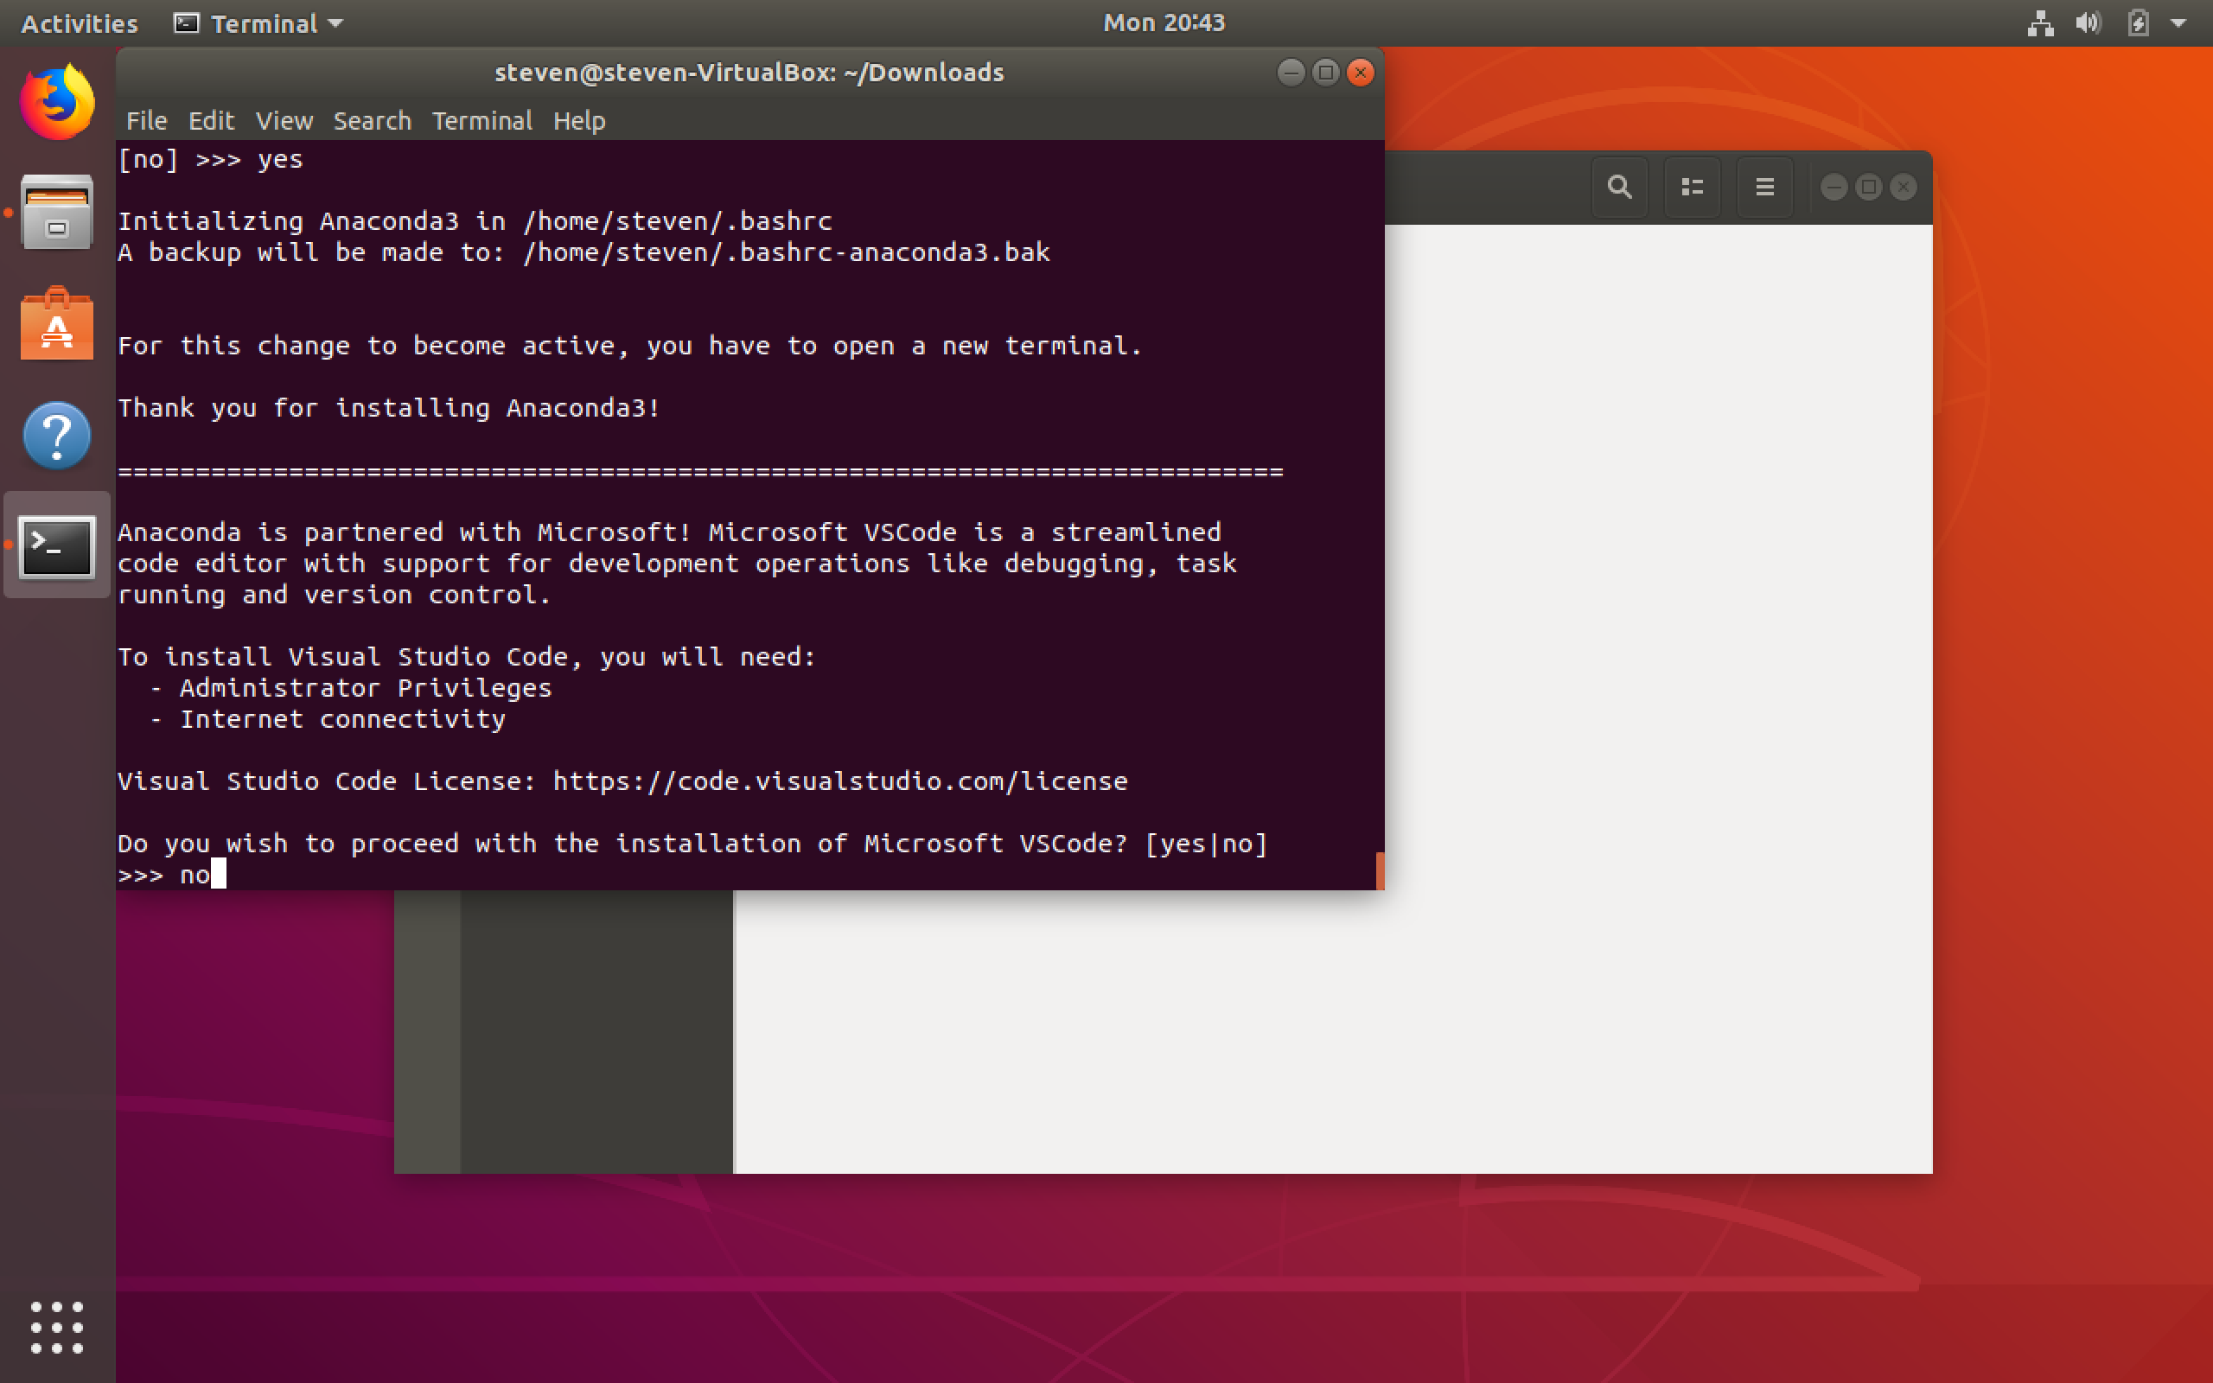
You do not need VSCode

Slide 16

Restart the terminal and check installation

Slide 17
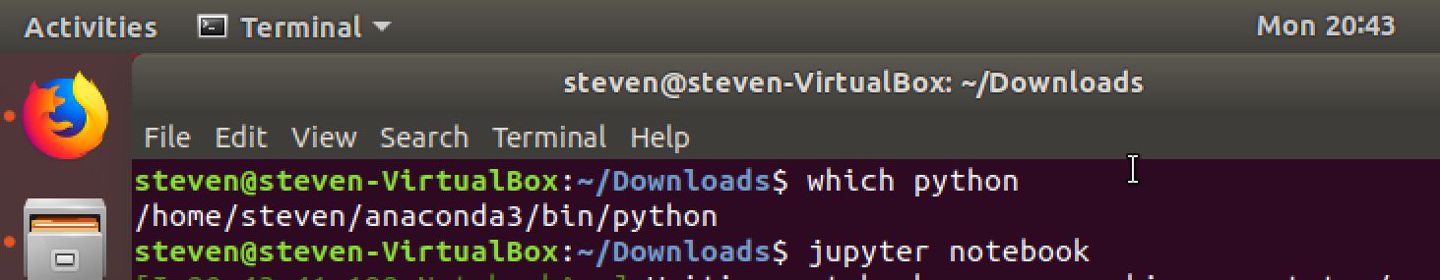
Launch Jupyter

Slide 18
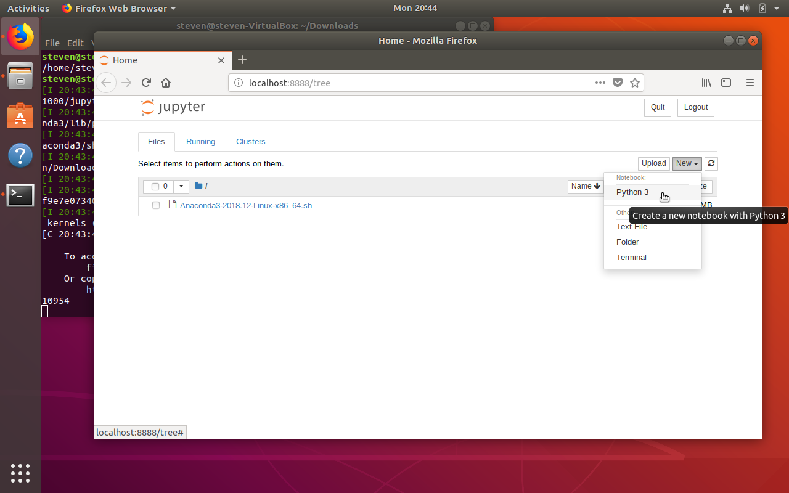
Create a Notebook

Slide 19
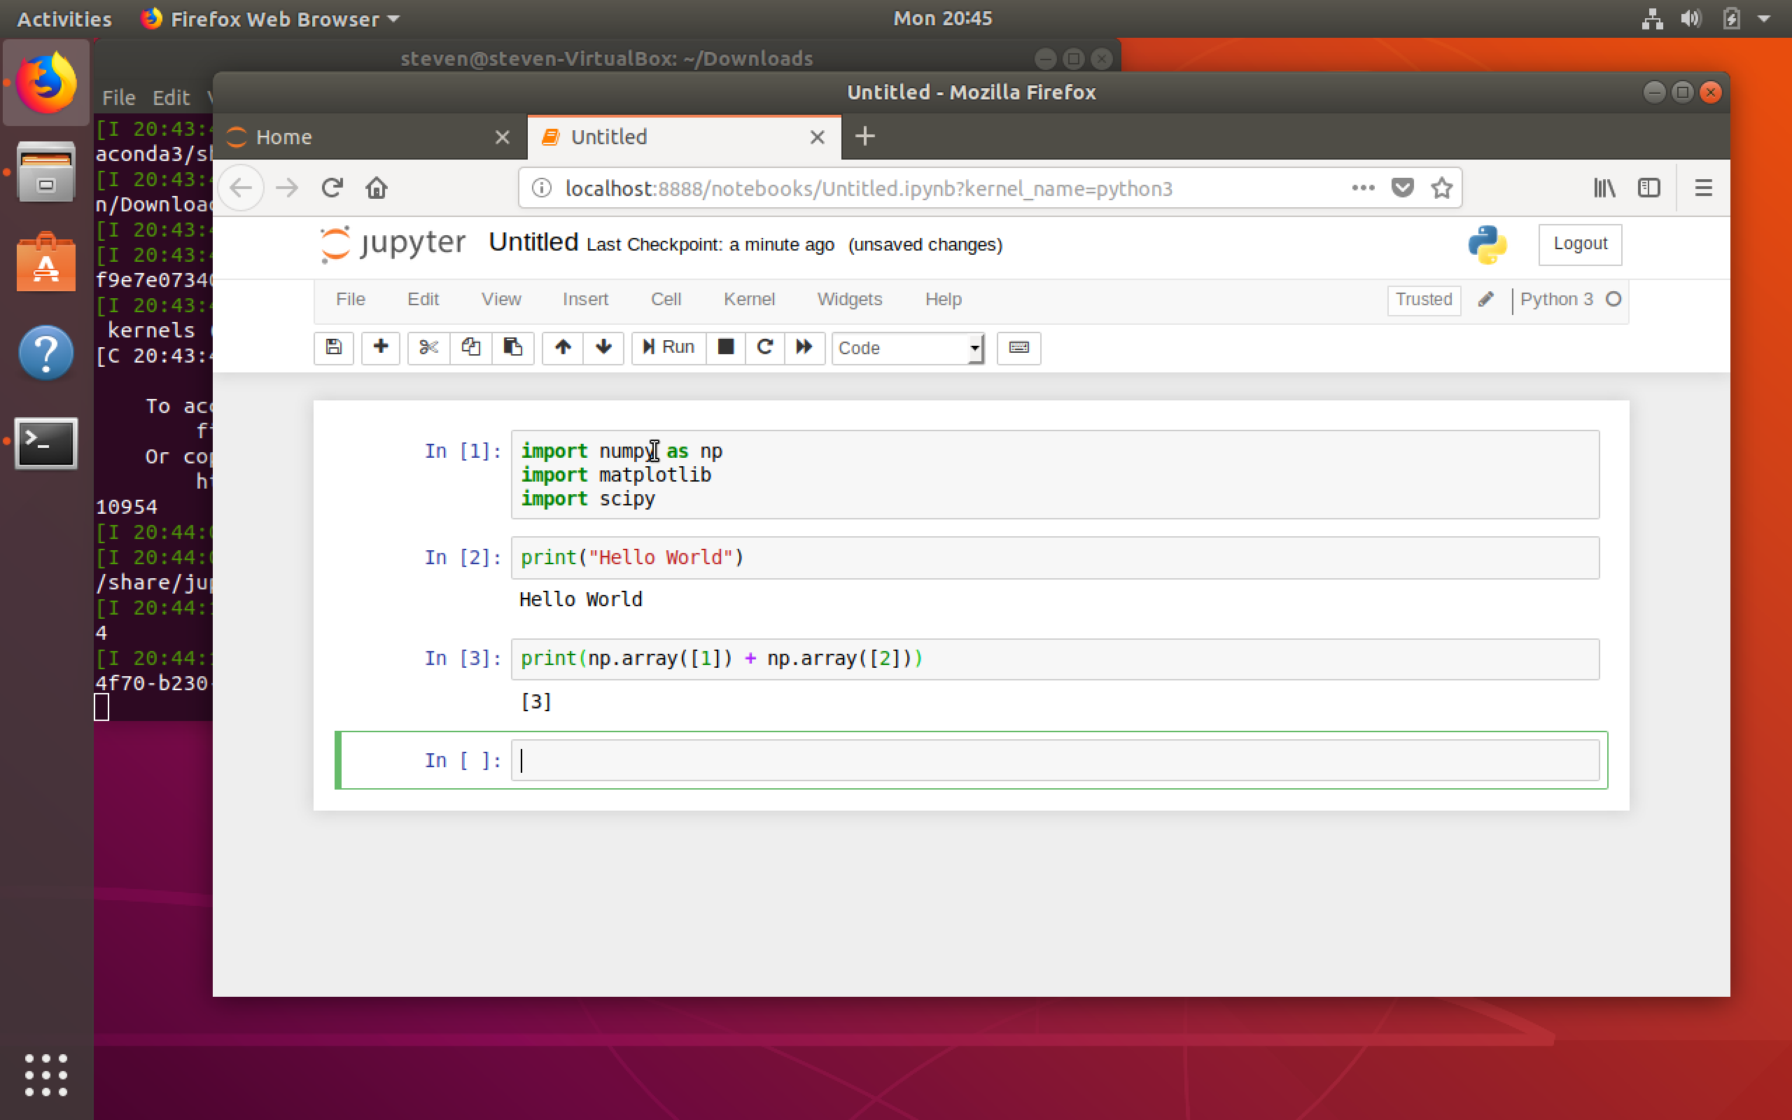
Do computer science stuff..

Slide 20
Installing Anaconda Windows 10
Surprisingly easy actually..

Slide 21
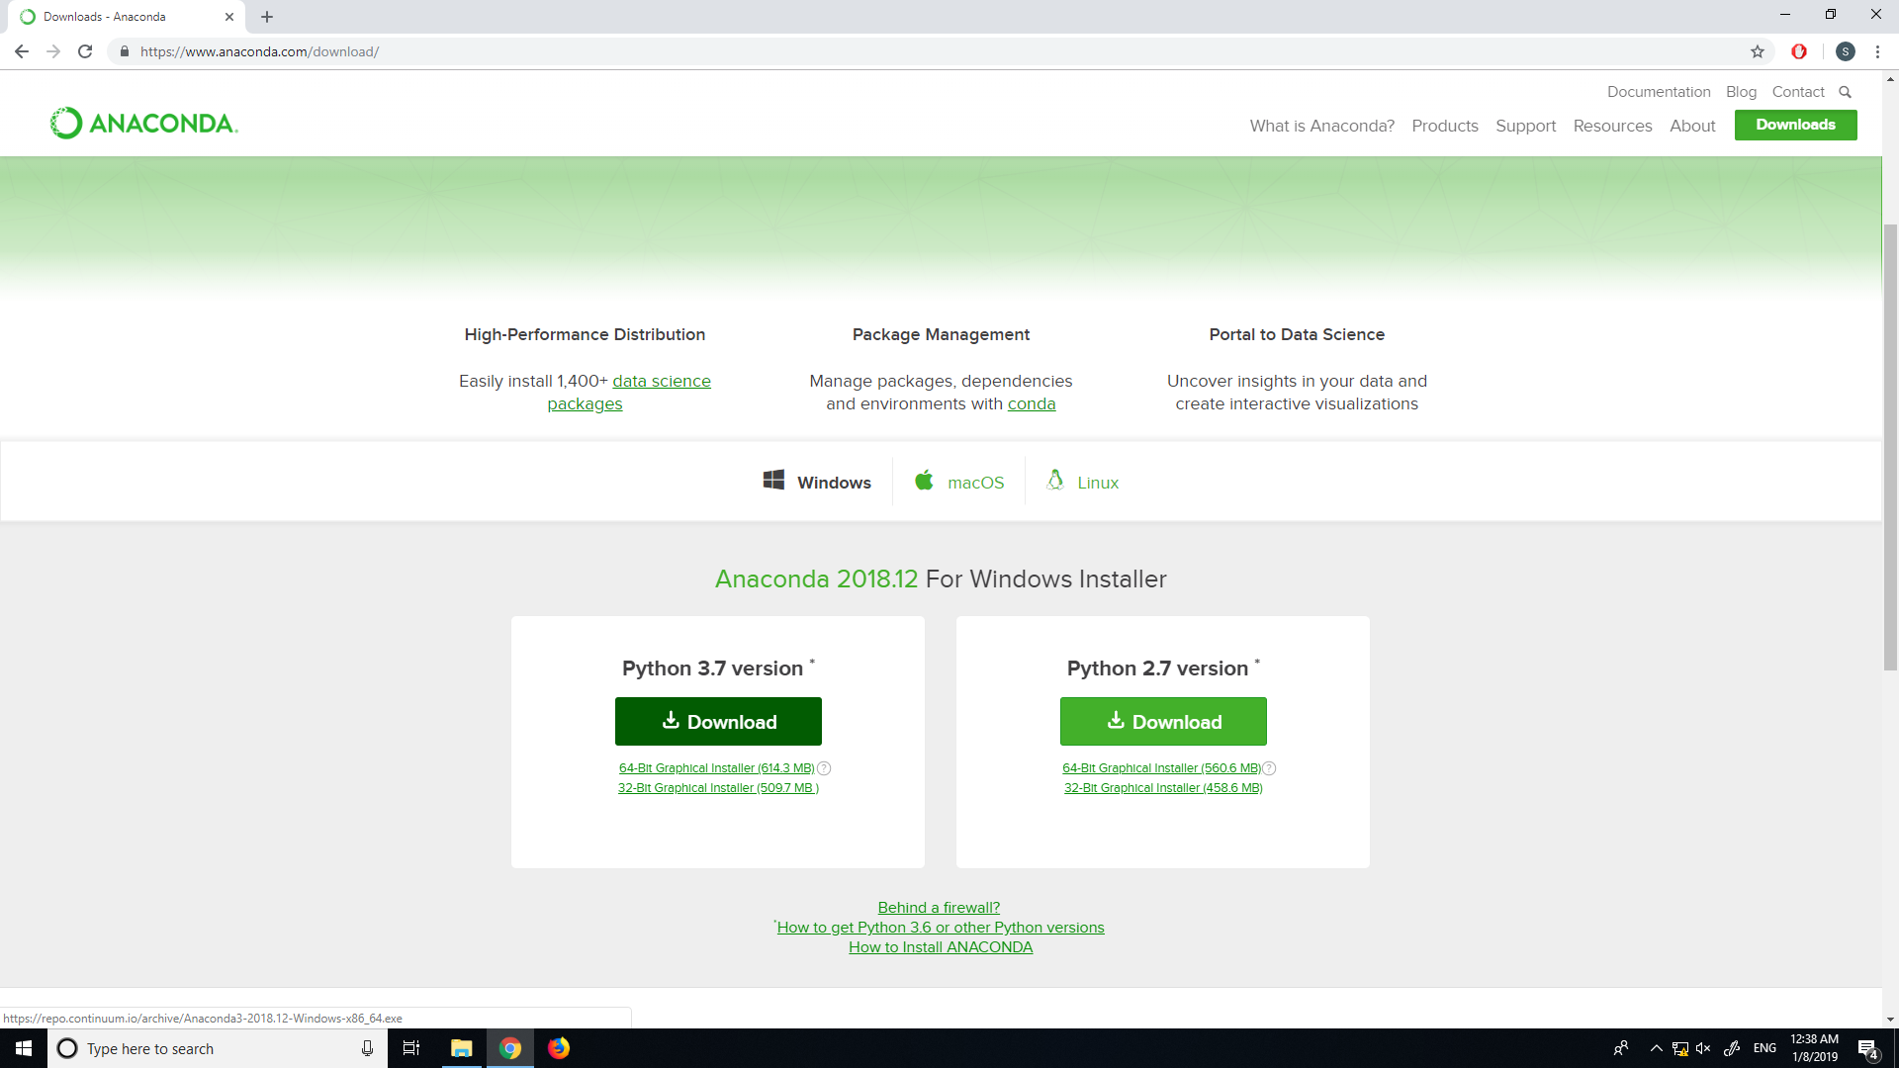
Go to the Anaconda Website
Click here

Slide 22
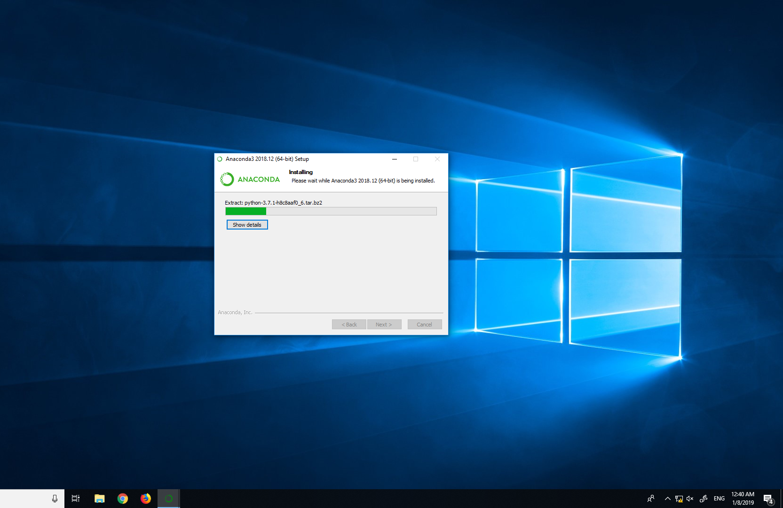
Open the .exe
Mindlessly hit “next” until it is greyed out

Slide 23
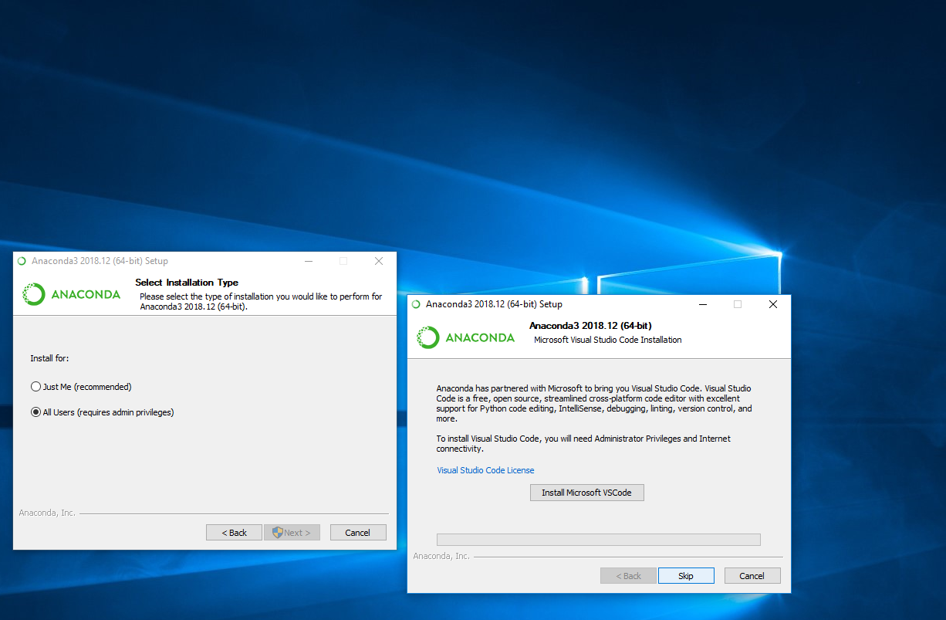
Skip VScode

Slide 24
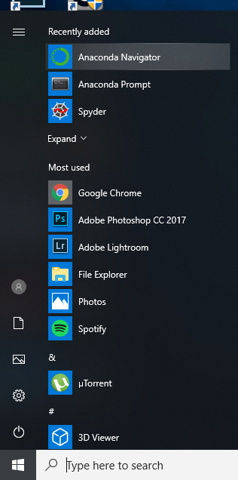
Find the Anaconda Navigator
Click here

Slide 25
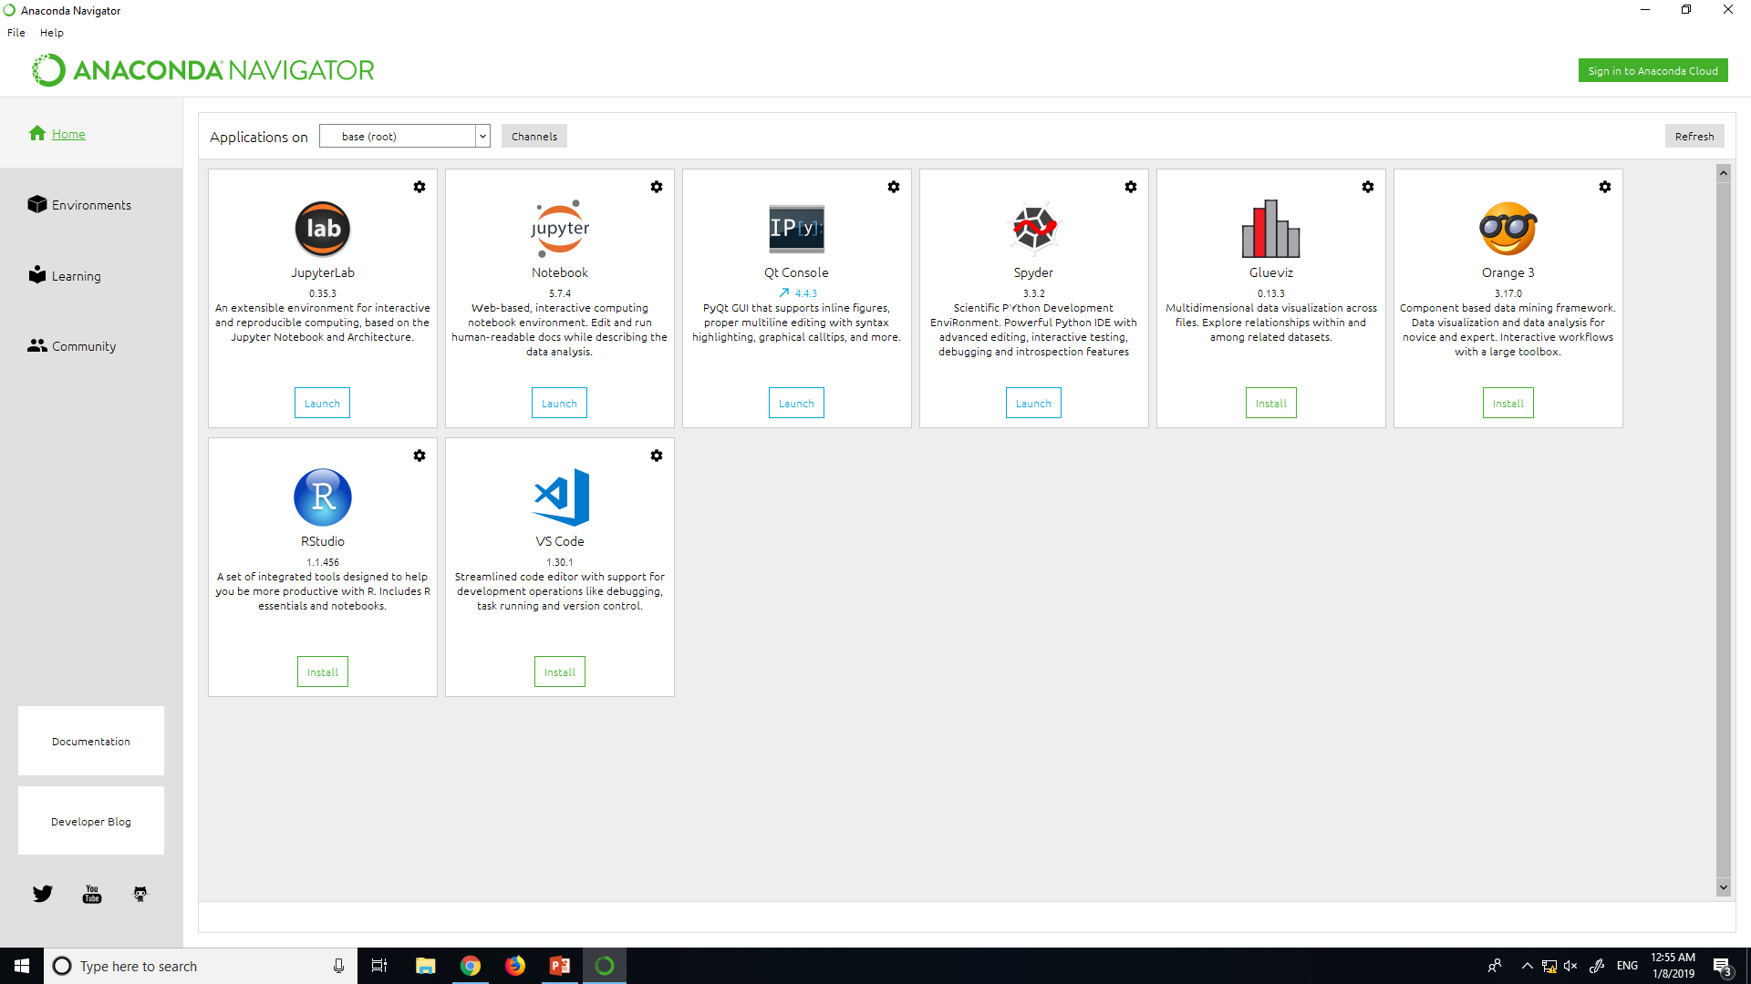
Find Jupyter
Click here

Slide 26
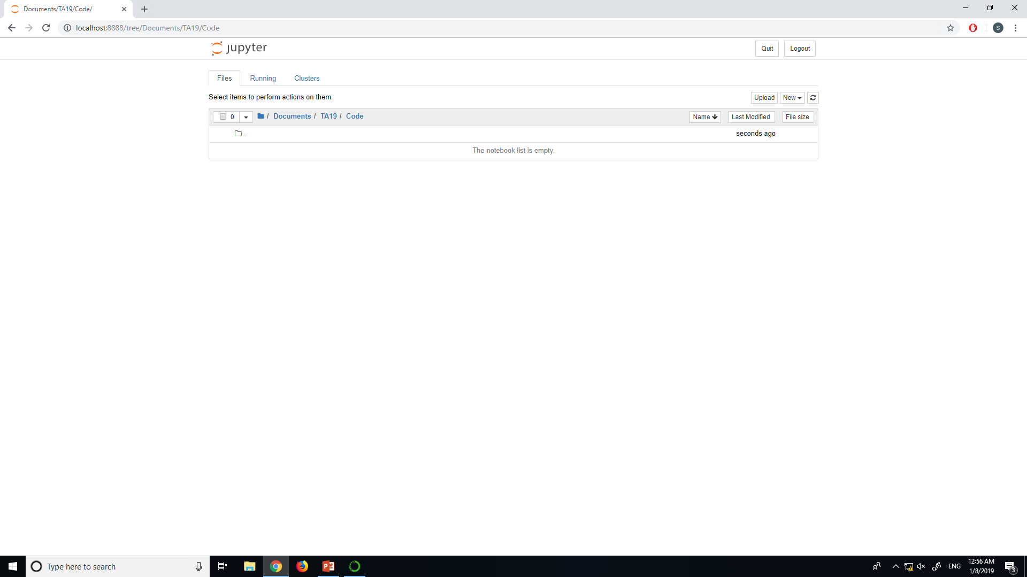
Navigate to Your Directory

Slide 27
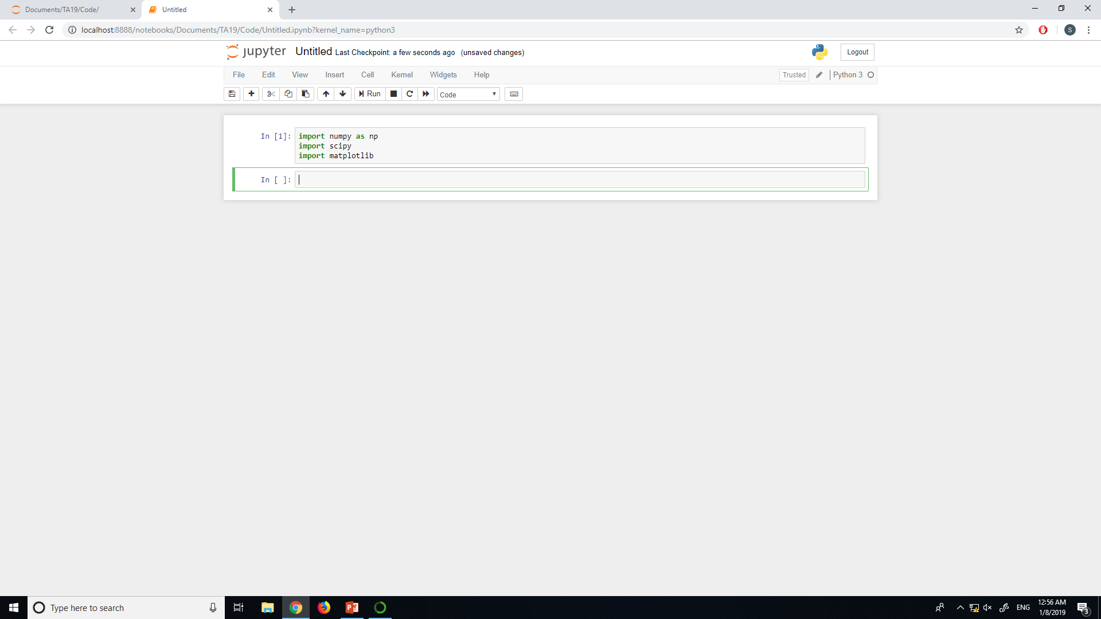
New > Python3 notebook

Slide 28
Discussion Section Objectives
Install Anaconda on your computer
Witness the power of matplotlib
Survey debugging tools for Jupyter
Grasp the importance of visualization

Slide 29
Discussion Section Objectives
Install Anaconda on your computer
Witness the power of matplotlib
Survey debugging tools for Jupyter
Grasp the importance of visualization

Slide 30
Urban Spatial Order: Street Network Orientation, Configuration, and Entropy
My favorite visualization paper

Slide 31
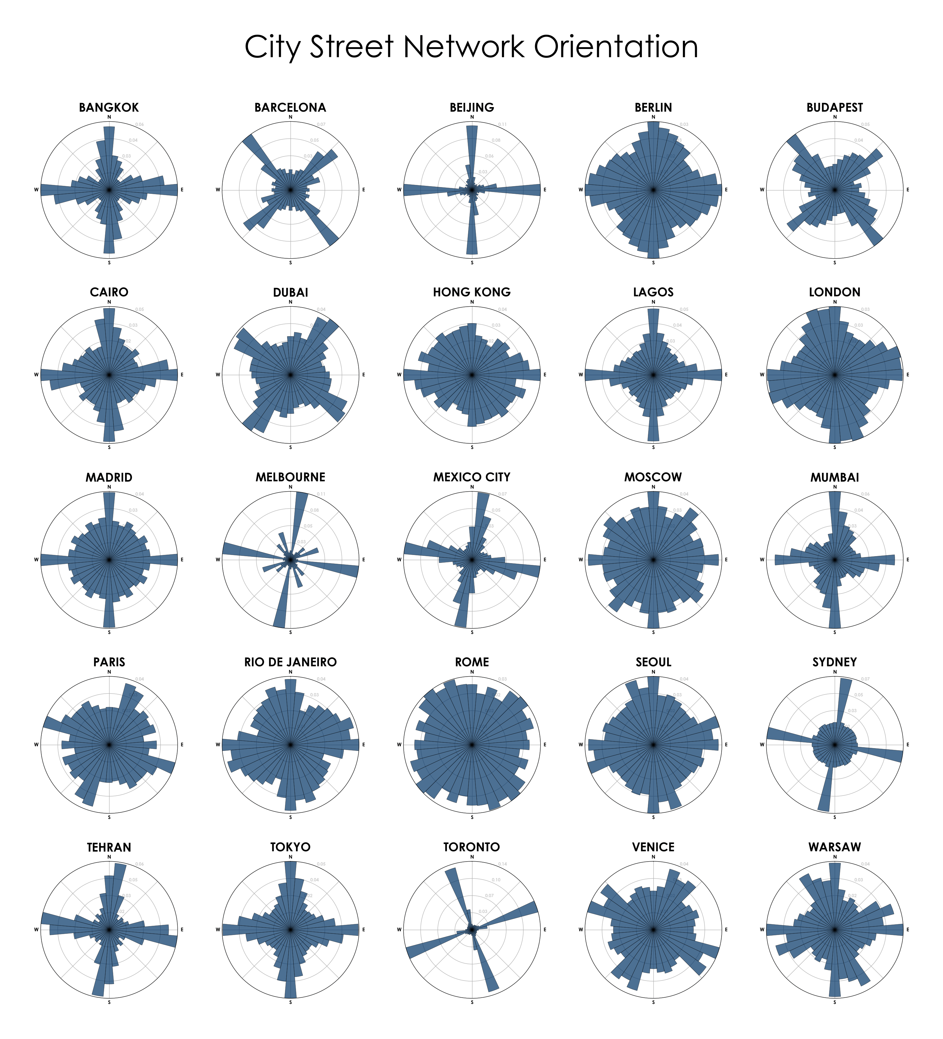

Slide 32
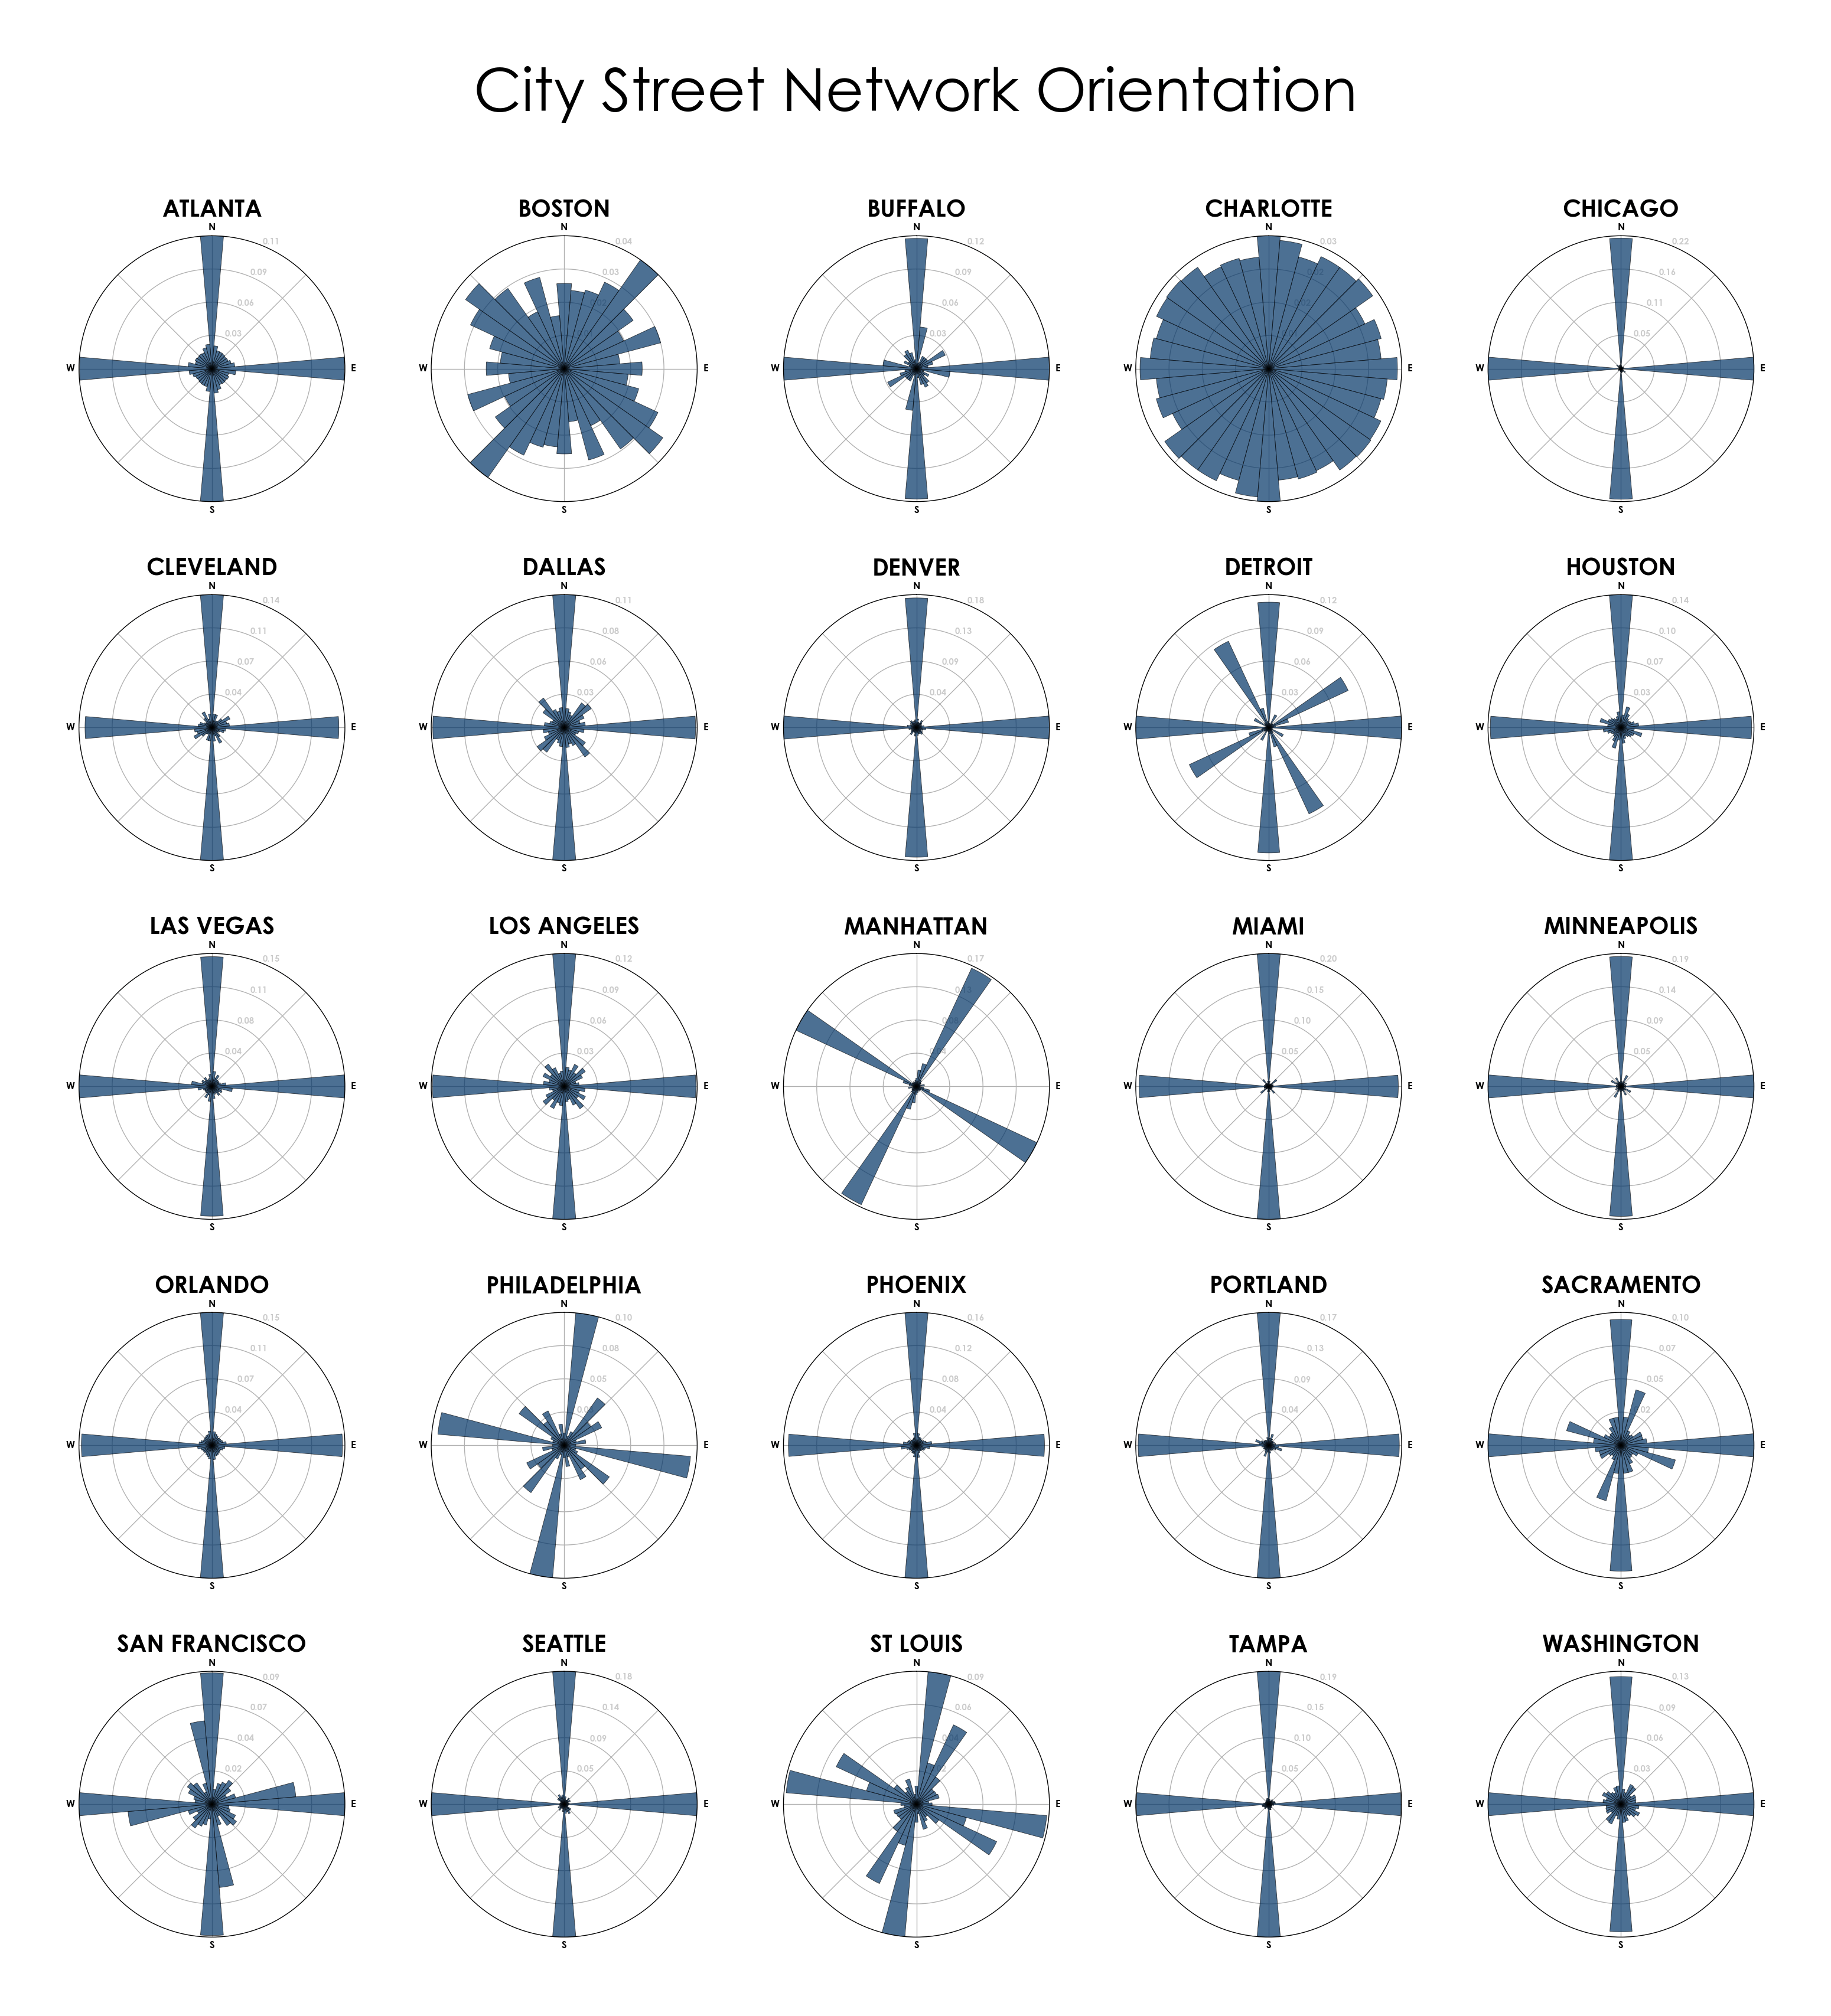

Slide 33
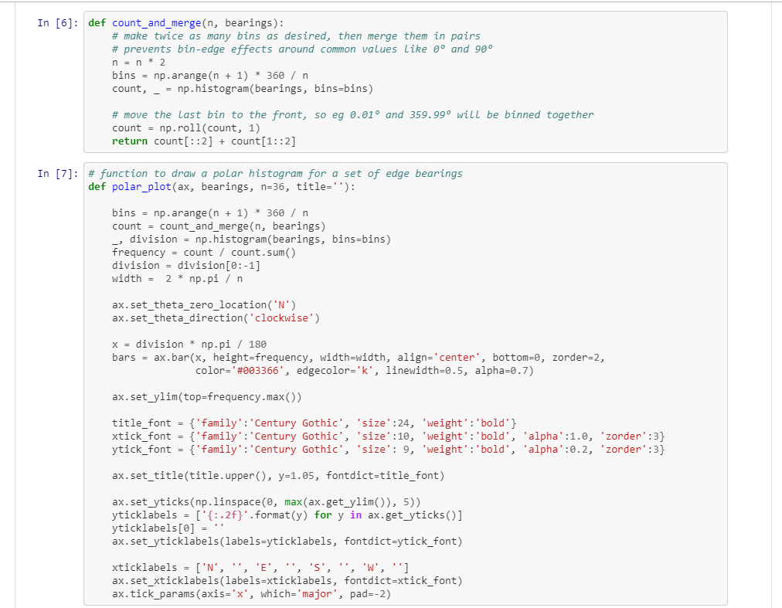
Just a Matplotlib Polar Plot
Store orientation counts in a numpy array
Make a polar plot, bar angles = street orientations
Full code available at,
https://github.com/gboeing/osmnx-examples/blob/master/notebooks/17-street-network-orientations.ipynb

Slide 34
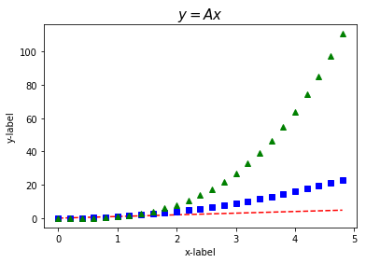
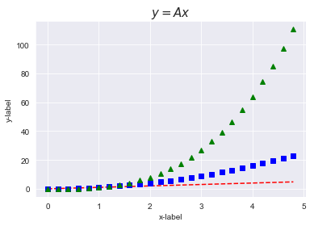
Matplotlib Styles

Slide 35
Simple Scripts
Matplotlib recipes notebook..

Slide 36
Discussion Section Objectives
Install Anaconda on your computer
Witness the power of matplotlib
Survey debugging tools for Jupyter
Grasp the importance of visualization

Slide 37
Discussion Section Objectives
Install Anaconda on your computer
Witness the power of matplotlib
Survey debugging tools for Jupyter
Grasp the importance of visualization

Slide 38
Pinpointing Problems with Jupyter
Jupyter debugging notebook..

Slide 39
Discussion Section Objectives
Install Anaconda on your computer
Witness the power of matplotlib
Survey debugging tools for Jupyter
Grasp the importance of visualization

Slide 40
Discussion Section Objectives
Install Anaconda on your computer
Witness the power of matplotlib
Survey debugging tools for Jupyter
Grasp the importance of visualization

Slide 41
Plots Are Often the Best Way to Find Bugs

Slide 42
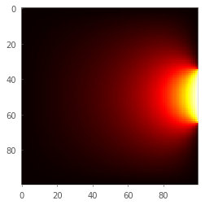
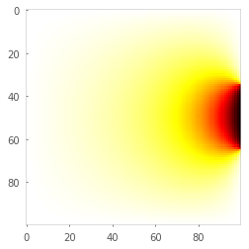
The Temperature Problem
Bug Free
Buggy

Slide 43
Where is the coldest part of the room?

Slide 44
Debugging Computational Code
Check for error messages and common mistakes (pointwise instead of matrix multiplication, forgot to execute parts of the script, ..)
Plot your results, try to identify the specific issues and isolate them
Think about the most difficult step in your calculations, check all the variables before this step, then check the variables after this step
Think about 2nd most difficult step in your calculations and repeat 3
Etc. until you find a step where the results don’t make sense

Slide 45
Discussion Section Objectives
Install Anaconda on your computer
Witness the power of matplotlib
Survey debugging tools for Jupyter
Grasp the importance of visualization

Slide 46
Discussion Section Objectives
Install Anaconda on your computer
Witness the power of matplotlib
Survey debugging tools for Jupyter
Grasp the importance of visualization

Slide 47
Group Exercise:
Split into groups of 3 to 5 (3 preferred)
Write your names
Memorize each other’s names
Write a sentence or less to answer: What is most important problem computers will solve in a foreseeable future?
Example 1: Autonomous driving
Example 2: Finding the optimal syrup to pancake ratio for breakfast

